Slide 1

PRIORITY SETTING & RESOURCE ALLOCATION PROCESS PRESENTATION
PBC HIV CARE Council PSRA 2024

Slide 2

PRESENTATION OUTLINE
□ Overview
□ What is PSRA?
□ PSRA Goals and Guiding Principles
□ Who’s Involved?
□ PSRA Process
□ Required Grant PSRA Documentation
□ PSRA Data Resources
□ PRSA Process: Step-By-Step
□ Ground Rules
□ What to Expect

Slide 3
OVERVIEW
□ HRSA Requirements: The Planning Council is required by HRSA to “set priorities and allocate resources for service categories and provide guidance (directives) to the Part A Recipient on how best to meet these priorities.”
► The Priority Setting & Resource Allocation (PSRA) Committee shall recommend priorities and resource allocations to the PBC HIV CARE Council to disburse Ryan White Part A funds in Palm Beach County.
► Priority Setting and Resource Allocation to service categories involves all members of the HIV Priority & Allocation committee .

Slide 4
PRIORITY SETTING
□ Priority setting is the process of deciding which HIV/AIDS services are the most important according to the criteria your EMA/TGA has established.

Slide 5

RESOURCE ALLOCATIONS
□ Resource allocation is the process of distributing available Ryan White Part A program funds for your EMA/TGA across the prioritized service categories.
□ Reallocation is the process of moving program funds across service categories after the initial allocations are made. This may occur right after grant award and during the program year when funds are underspent in some service categories and additional needs exist in other service categories.
□ The planning council must approve such reallocations.

Slide 6
PSRA GOALS AND GUIDING PRINCIPLES
□ Provide access to high quality HIV services for PLWHA in Palm Beach County
□ Optimize the HIV Care Continuum’s impact
□ Develop an integrated PSRA process using data with input from stakeholders and consumer forums
□ Maintain a commitment to ending health disparities
□ Provide client centered and coordinated services
□ Integrate Prevention and Care
□ Maintain and require collaborative partnerships among service providers
□ Encourage early and meaningful involvement from PLWHA in the development, implementation, and evaluation of service delivery
□ Engage continuous training, capacity building, and leadership development
□ Provide culturally and linguistically appropriate services

Slide 7
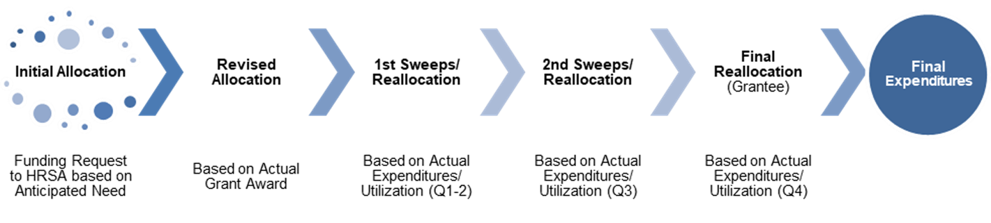
PALM BEACHCOUNTY ANNUAL RESOURCE ALLOCATION/REALLOCATION CYCLE

Slide 8
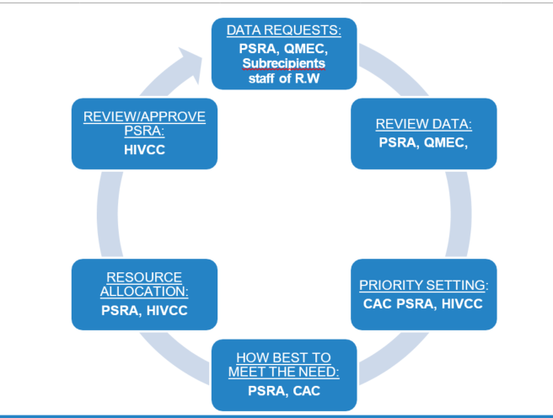
WHO IS INVOLVED?

Slide 9
PLWHA INVOLVEMENT IN THE PSRA PROCESS
□ PLWHA Serve as Committee Members:
► Priority and Allocation Committee – P&A
• Data Collection (focus groups/feedback forums) & Presentation
• Rank Core Services Priorities
• Rank Support Service Priorities
► Community Awareness Committee – CAC
• How Best to Meet the Need
► PSRA
• Priority Setting & Resource Allocation
► HIVCC
• Approves All PSRA Decisions
□ Community Feedback Through Needs Assessment Activities:
► 2023 Needs Assessment
• (Considers the needs of PLWHA from differing populations and geographic locations, including those in and out of care.)

Slide 10






THE PSRA PROCESS
Develop PSRA Principles and Criteria
Clarify Committee, Consumer & Staff Roles and Responsibilities
Develop PSRA Timeline
Principles
  Review HRSA Mandates and Part A PSRA Grant Guidance
  Identify HRSA Identified and Additional Data Sources
  Create User Friendly Data Sets
Data
Committee and Community Data Presentations
Develop Language On How Best To Meet The Need
Committee Reviews Data/Factors to Consider & Sets Priorities
Committee Reviews Data/Factors to Consider & Allocates Resources
Decisions

Slide 11

REQUIRED PART A GRANT PSRA DOCUMENTATION
The Part A Grant Application requires documentation about the PSRA process annually.
► Questions to be aware of includes:
• How PLWHA were involved in the PSRA process and how their priorities are considered in the process
• How data were used in the PSRA processes to increase access to core medical services and to reduce disparities in access to the continuum of HIV/AIDS care
• How the HIVCC used changes and trends in HIV/AIDS epidemiology data in the PSRA process
• How the Planning Council used cost data in making funding allocation decisions
• How the Planning Council used unmet need data in making priority and allocation decisions
• How the Planning Council’s process will prospectively address any funding increases or decreases in the Part A award

Slide 12
PSRA DATA SOURCE
Priorities and allocations are data based. Decisions are based on the data, not on personal preferences.
The PSRA Committee will have access to information to enhance their efforts in the decision-making process.
The data collected includes:
□ Epidemiological Data
□ Fiscal and Service Utilization Data
□ Needs Assessment Data
□ Others Funder’s Data/Presentation

Slide 13
PSRA DATA SOURCES (CONT’D)
Other factors to consider are:
□ Funding from other sources such as Medicaid and Medicare
□ Developing capacity for HIV services in historically underserved communities
□ Priorities of Ryan White Consumers
□ Changes in legislative requirements
□ National HIV/AIDS Strategy
□ Affordable Care Act

Slide 14
OTHER RESOURCES
□ PSRA Policies and Procedures
□ FDOH HIV/AIDS Partnership 10 Epidemiological Profile, 2023
□ FY2023 Other Funders Table
□ FY2023 Part A Scorecards, Expenditures Spreadsheet, and Projections Table
□ Needs Assessment Activities Report
□ FY2023 Rankings Table
□ FY2023 Part A Allocations Table

Slide 15
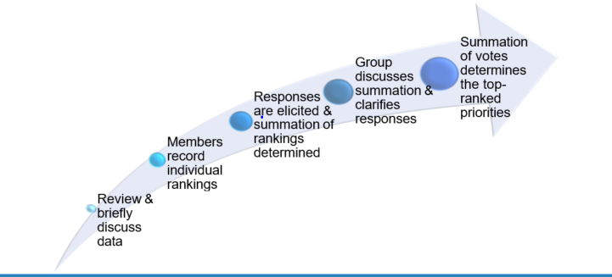
PSRA PROCESS: STEP-BY-STEP
PRIORITY SETTING
Prioritize all service categories included in Legislation
Utilize priority rankings, consumer feedback, and other PLWHA data provided
Utilize Nominal Group Process Method

Slide 16
PRIORITY SETTING: CORE SERVICES
SERVICE CATEGORY Health Insurance
Mental Health Services
Medical Case Management
Outpatient/Ambulatory Medical Care (Specialty Outpatient, Labs)
Oral Health Care
Early Intervention Services (EIS)
Substance Abuse Outpatient Care
AIDS Pharmaceutical Assistance
Home and Community-Based Health Services
Medical Nutrition Therapy
Hospice
Home Health Care

Slide 17
PRIORITY SETTING: SUPPORT SERVICES
SERVICE CATEGORY
Emergency Housing Services
Medical Transportation
Food Bank/Home Delivered Meals (Nutritional Supplements)
Non-Medical Case Management
Legal Services
Substance Abuse Residential
Psychosocial Support Services
Emergency Financial Assistance (EFA-Prior Authorizations)
Child Care Services
Health Education / Risk Reduction
Linguistic Services
Permanency Planning
Outreach Services
Referral for Health Care and Support Services
Rehabilitation Services
Respite Care

Slide 18
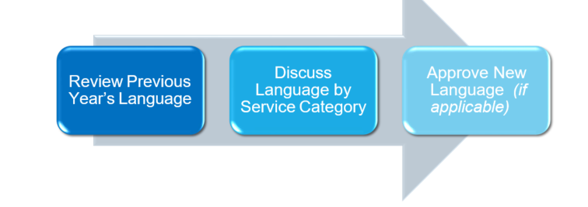
LANGUAGE ON HOW BEST TO MEET THE NEED
Directives to the Part A Recipient on how best to meet the service priorities identified, such as:
Where geographically to fund services
Specific models to use
Identify target populations for which to implement new/improved services or interventions.

Slide 19
ADDITIONAL PRIORITIES & LANGUAGE CONSIDERATIONS
Priorities Language should be based on:
Cost and Outcome Effectiveness
Priorities of PLWHA
Documented need
Availability of other resources

Slide 20
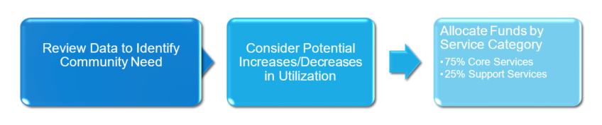
RESOURCE ALLOCATIONS
Decide how much funding will be used for each service category

Slide 21
REALLOCATIONS (SWEEPS)
□ Reallocation is the process of moving program funds across service categories after the initial allocations are made. The PSRA Committee shall review, at least quarterly, any deviations in planned expenditures exceeding 10%* in any given funding category for possible reallocation and/or reprioritization.
► Periodic Reallocation: The Part A Recipient will present the Committee with estimates of funding deviations with an explanation as to possible causes of the deviation. The funding should be maintained within the service category if possible.
► Final Reallocation: To fully expend funds at the end of the fiscal year, the PSRA / P&A Committee authorizes the Part A Recipient to move funds between categories within a service provider's contract. This authority is given to understand that the reallocation process has occurred before this shifting of funds. The number of dollars involved should be less than 10% of the funding award, and that there are less than 120 days left in the fiscal year.**

Slide 22
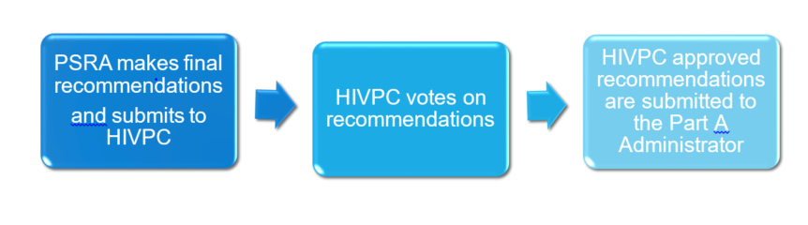
PSRA APPROVAL
The PSRA or Priority and Allocation Committee forwards all recommendations to the HIV CARE Council /Planning Council for approval.

Slide 23
PSRA APPROVAL
The Grant Administrator (Part A Recipient) submits the CARE Council's PSRA recommendations to the Board of County Commissioners' designated Division Director, who in turn forwards them to the Palm Beach County Board of County Commissioners for its approval.

Slide 24
GROUND RULES
Every member will treat every other member with the courtesy and respect resulting from their legitimate right to be part of discussions and decision making. All members/participants in meetings will have the opportunity to speak and be listened to without interruptions.
There will be no personal attacks, and disagreements will focus on issues, not upon individuals.
Once decisions are made, every member of the Committee will support the decision, regardless of their personal position.
A member will behave in a manner that reflects recognition of their responsibility to present and consider the concerns of specific communities or population groups while considering the overall needs of PLWHA and acting on their behalf, not to for personal benefit.
Members should not name service providers and/or persons during any discussion unless the service provider or person is identified in the subject of the motion or agenda item. Specific concerns regarding service providers should be directed towards the Recipient outside of the meeting.
Every member will take responsibility for abiding by these rules of conduct personally and for speaking out to assure that all members abide by them.

Slide 25
PSRA COMMITTEE: WHAT TO EXPECT
The Care Council support staff will provide the essential materials needed for all activities. Also, provide background and support to all presentations for an informed decision-making process.
An immense amount of information will be distributed and presented within a short period of time: Since a tremendous amount of information needs to be considered for members to prioritize services and allocate funds, each member is obligated to become familiar with how to read the data being presented and to use the information to make informed decisions.

Slide 26


Slide 27

Open Forum Discussion/Q & A

