Slide 1
HUD CoC BUILDS NOFO
Technical Assistance Meeting
SEPTEMBER 26, 2024

Slide 2
CALENDAR FOR NOFO
Application Release Date: September 23, 2024
Application Due Date: October 22, 2024 (Noon)
Late Applications will not be accepted
CoC Non-Conflict Grant (NCG) Review Committee Meeting: November 4, 2024
Appeal Submission Deadline: November 7, 2024
Deadline for Collaborative Applicant

Slide 3
CONE OF SILENCE
The Cone of Silence is in effect as of the submittal deadline of October 22, 2024 and shall terminate at the time that the HSCA submits the chosen application to HUD
Cone of Silence" means a prohibition on any non-written communication regarding this NOFO between any applicant or applicant's representative and any County Commissioner or Commissioners staff, any member of a local governing body or the member's staff, a mayor or chief executive officer that is not a member of a local governing body or the mayor or chief executive officer that is not a member of a local governing body or the mayor or chief executive officer's staff, or any employee authorized to act on behalf of the Commission or local governing body to award a contract.

Slide 4
APPLICATION DEVELOPMENT
APPLICATION IS BASED ON THE HUD NOFO
APPLICATION IS COMPLETED BY THE ORGANIZATION REQUESTING FUNDS BUT MUST BE SUBMITTED BY THE COC COLLABORATIVE APPLICANT - PBC COMMUNITY SERVICES DEPARTMENT, DIVISION OF HUMAN SERVICES AND COMMUNITY ACTION (HSCA)

Slide 5
AVAILIBILITY OF HUD NOFO
THE HUD CoC BUILDS NOFO CAN BE FOUND AT:
https://www.hud.gov/program_offices/comm_planning/coc/cocbuilds

Slide 6
NOFO BASICS
ONE TIME GRANT
UP TO $7.5 MILLION LOCALLY
APPLICATION MUST BE SUBMITTED BY THE CoC
ONLY ONE APPLICATION MAY BE SUBMITTED
NATION-WIDE COMPETITION
HUD WILL CHOOSE 25 APPLICATIONS

Slide 7
NOFO BASICS
MUST BE NEW UNITS OF PERMANENT SUPPORTIVE HOUSING
CONSTRUCTION, ACQUISITION, OR REHABILITATION
BENEFICIARIES MUST BE HOMELESS INDIVIDUALS OR FAMILIES IN WHICH AT LEAST ONE MEMBER HAS A DISABILITY
NEED TO SHOW HOW NON-CoC FUNDS WILL BE LEVERAGED
LENGTH OF PROJECT 24 – 60 MONTHS – CAN APPLY FOR 2, 3,4, OR 5 YEAR AWARDS.
MULTIPLE SUBRECIPIENTS ARE ENCOURAGED.
MUST BE CONSISTANT WITH THE CONSOLIDATED PLAN

Slide 8
NOFO BASICS
PROJECTS SELECTED BY HUD FOR CONDITIONAL APPROVAL MUST:
  PROVIDE PROOF OF SITE CONTROL PRIOR TO EXECUTION OF THE GRANT
  EXECUTE THE GRANT AGREEMENT WITH HUD NO LATER THAN SEPTEMBER 1, 2025
  HAVE A COMPLETED ENVIRONMENTAL REVIEW BEFORE FUNDS CAN BE DRAWN FOR PROJECT ACTIVITIES
  MEET TIMELINESS STANDARDS OUTLINED IN 24 CFR 578.85 FOR NEW CONSTRUCTION OF REHABILITATION ACTIVITIES

Slide 9
USE OF FUNDING
CONSTRUCTION, ACQUISITION, OR REHABILITATION OF UNITS OF PERMANENT SUPPORTIVE HOUSING
UP TO 20% OF FUNDING MAY BE SPENT ON SUPPORT SERVICES AND OPERATING COSTS
UP TO 10% MAY BE SPENT ON ADMINISTRATION

Slide 10
USE OF FUNDING
THE APPLICATION MUST DESCRIBE THE TYPE OF CAPITAL COSTS BEING REQUESTED – NEW CONSTRUCTION, ACQUISITION OR REHABILITATION
STATE IF REQUESTING OPERATING COSTS OR SUPPORTIVE SERVICES (UP TO 20%) AND ADMINISTRATIVE COSTS (UP TO 10%)
MAJORITY OF FUNDING REQUEST MUST BE FOR CAPITAL COSTS

Slide 11
ELIGIBLE COSTS
ACQUISITION
REHABILITATION
NEW CONSTRUCTION
PROJECT-BASED RENTAL ASSISTANCE
SUPPORTIVE SERVICES
OPERATING COSTS
ADMINISTRATIVE COSTS

Slide 12
MATCH
THE RECIPIENT OR SUBRECIPIENT MUST MATCH ALL GRANT FUNDS, EXCEPT FOR LEASING FUNDS, WITH NO LESS THAN 25 PERCENT IN CASH OR IN-KIND CONTRIBUTIONS FROM OTHER SOURCES.

Slide 13
ELIGIBLE APPLICANTS
Non-profit Organizations
States
Local Governments
Instrumentalities of State and Local Governments
Indian Tribes
Public Housing agencies
For-profit entities are ineligible to apply and are prohibited from being subrecipients; individuals, foreign entities and sole proprietorships are also excluded.

Slide 14
APPLICATION SUBMISSION
DEADLINE FOR SUBMISSION TO THE COC IS OCTOBER 22, 2024
Late applications will not be accepted.
Incomplete applications cannot be cured by the NCG Review Committee. If an application is incomplete, the application will be scored accordingly

Slide 15
APPLICATION IS A FIVE STEP PROCESS
Step 1: Using the HUD NOFO the project applicant develops the project application. The HUD NOFO is available at https://www.hud.gov/program_offices/comm_planning/coc/cocbuilds
Step 2: CoC BUILDS PROJECT APPLICANTS upload their PROJECT APPLICATIONS into the PBC CSD
NOFO website, Web Author (SAMIS) located at https://pbcc.samis.io/go/nofo/ The project application must be submitted through SAMIS by the project application deadline, which is October 22, 2024 at 12:00 p.m. Noon, EST.

Slide 16
STEP 3
Step 3: Project applicants will print the project application to pdf and submit the entire project application package, including all required attachments and match documentation, by email to the collaborative applicant at CSD-BUILDS-NOFO@PBC.GOV by the project application deadline date, which is October 22, 2024, at 12:00 p.m. Noon, EST.
To access the NOFO Invitation Code, applicants must review the SAMIS Access Guide

Slide 17
STEPS 4 & 5
Step 4: If more than one PROJECT APPLICATION is received, each PROJECT APPLICATION will be rated by the NCG Review Committee and their recommendation for the application to be submitted to HUD will be presented to the HHA Governance Board for approval.
Step 5: The COLLABORATIVE APPLICANT will enter the PROJECT APPLICATION into grants.gov for submission to HUD

Slide 18
APPLICATION DEVELOPMENT
The responses required for the application are outlined in the HUD NOFO Section V. A. Review Criteria.
Each response has a specific number of pages allowed
Responses must be typed in Times New Roman, 12 pitch font, 8 ½ X 11 page size, with a one inch margin on all sides.
The Rating Factor should be used as the heading for each response.
There are also four Equity narratives required for this application, three of which are required but not scored by HUD. Please see Section III F of the HUD NOFO

Slide 19
APPLICATION DEVELOPMENT
The total number of pages (excluding the budget) cannot exceed 25 pages
Some federally required forms may only be submitted through grants.gov at the time of application submission to HUD. These forms will be required to be completed by the successful PROJECT APPLICANT prior to the time of submission by the COLLABORATIVE APPLICANT and do not have to be submitted in your response to this NOFO. These forms are those listed in Section IV B 1 of the HUD NOFO.

Slide 20
HELPFUL INFORMATION FROM HUD
HUD FAQs, Transcripts and Slides:
https://www.hud.gov/program_offices/comm_planning/coc/cocbuilds has FAQs which may be very helpful in developing the PROJECT APPLICATION
Transcript and slides of a CoC BUILDS webinar on the same site which may also be very helpful

Slide 21
Important Program Guidance
Local NOFO Application Program Guidance
https://discover.pbcgov.org/communityservices/humanservices/Pages/CoC-Grant-Apps.aspx
Continuum of Care Program Interim Rule
https://www.hudexchange.info/resource/2033/hearth-coc-program-interim-rule
HUD CoC BUILDS NOFO
https://www.hud.gov/program_offices/comm_planning/coc/cocbuilds

Slide 22
REVIEW CRITERIA
The CoC Non-Conflict Grant Review Committee will choose the application to be submitted to HUD using the same criteria that HUD will use to select the winning applications
BASED ON A 100 POINTS

Slide 23
HUD and CoC RATING FACTORS
SECTION V.A.1
Development Experiencing and Leveraging
Managing Homeless Projects
Implementation Schedule
Property Maintenance
Unmet Housing Need
Management of Rental Housing

Slide 24
HUD and CoC RATING FACTORS
SECTION V.A.1 (cont.)
Coordinated Entry
Coordination with Housing Providers, Healthcare Organizations, and Social Service Providers
Experience Promoting Racial Equity
Community Integration for Persons with Disabilities
Section 3 Requirement
  Employment And Training
  Including access to contracting and other economic opportunities.

Slide 25
QUESTIONS???
Local NOFO: CSD-BUILDS-NOFO@PBC.GOV
HUD NOFO: COCBUILDS@HUD.GOV
HSCA Staff Contact: Jean-Marie Moore, Program Evaluator jmoore@pbc.gov

Slide 26


SAMIS Application
Elcana Dantzler, Contracts/Grants Coordinator

Slide 27
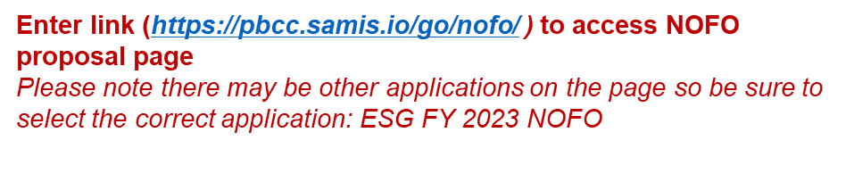
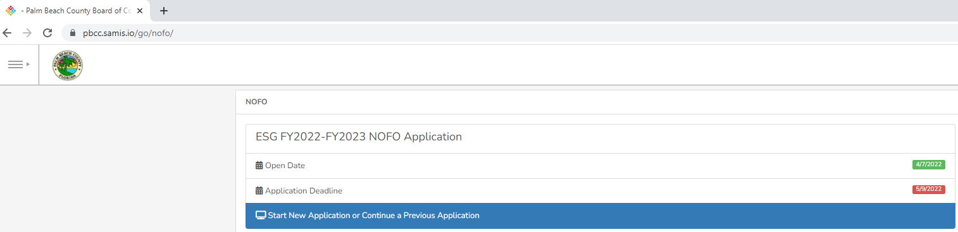






Completing the 2024 COC BUILDS LOCAL PROJECTS NOFO
Click here to begin a new application or continue to complete an application already started

Slide 28
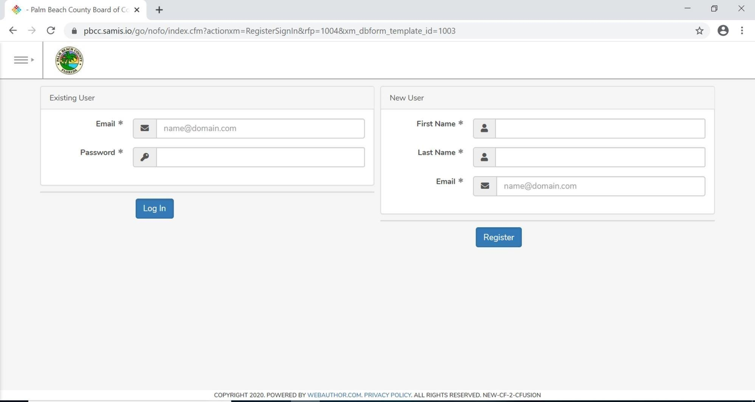
Completing the 2024 COC BUILDS LOCAL PROJECTS NOFO
If previously submitted an application through SAMIS, you will use the email and password you created to log in under “Existing User.”
If you are a brand new SAMIS user, you will type in your first name, last name and email under “New User” to begin the process for creating an
account. By creating an account, you will be able to return to an
application you have started and apply for future grants using your previously created account.

Slide 29
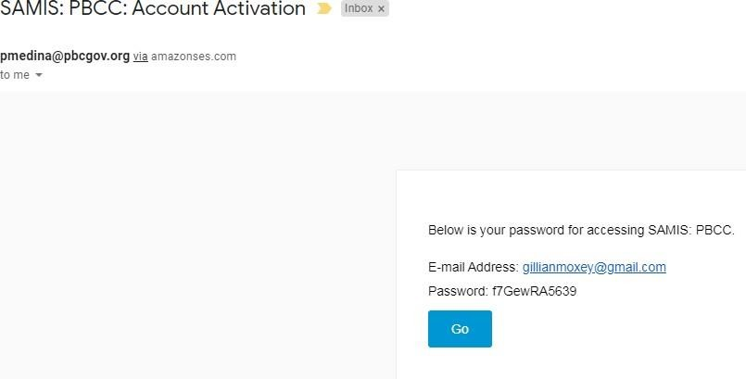
Completing the 2024 COC BUILDS LOCAL PROJECTS NOFO
For new users, you will receive an email with
subject line :SAMIS:PBCC: Account Activation.
This email will contain your password to sign into SAMIS to complete the application

Slide 30
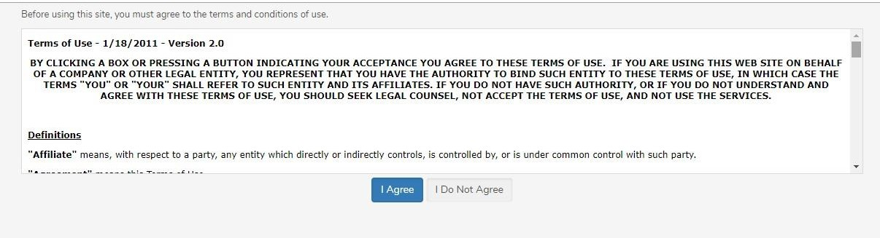
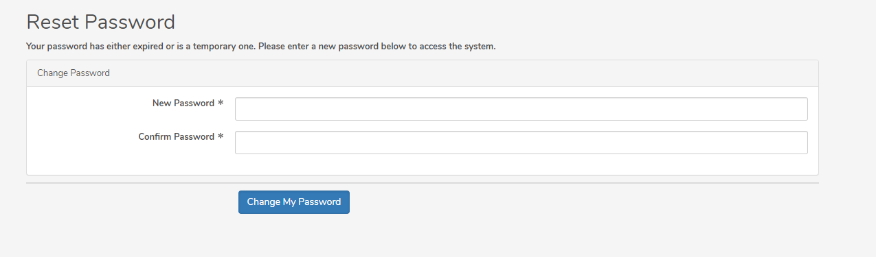
Completing the 2024 COC BUILDS LOCAL PROJECTS NOFO
…and, to change your password
You will be asked to accept the terms of use for SAMIS…

Slide 31

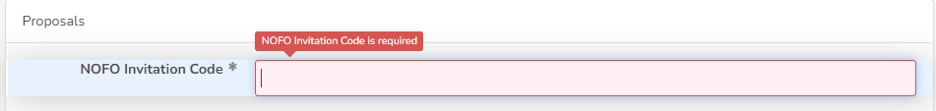



Completing the 2024 COC BUILDS LOCAL PROJECTS NOFO
The application will appear.
Enter the NOFO Invitation Code, located on the last slide of the SAMIS ACCESS Guide

Slide 32
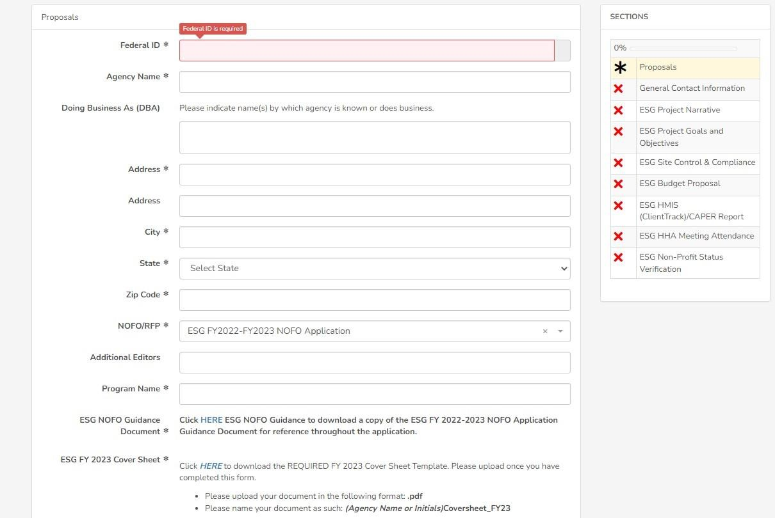


Completing the 2024 COC BUILDS LOCAL PROJECTS NOFO
A valid Federal ID will populate the applicant’s agency name and address.
Use this status panel to track your application’s progress. A green “✓” (checkmark) means the section is completed. A red “X” means the section is not completed.
Check the NOFORFP to confirm you are in the correct application

Slide 33




Completing the 2024 COC BUILDS LOCAL PROJECTS NOFO
Throughout the application, an “*” (asterisk) next to an item indicates that the field is required.
To add another reviewer/editor to the application, go to the “Additional Editors” field in the first section of the application (first page)

Slide 34
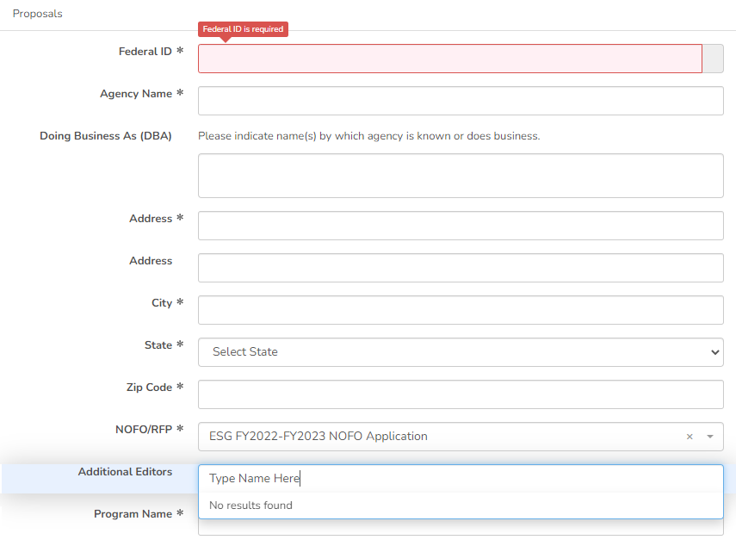


Completing the 2024 COC BUILDS LOCAL PROJECTS NOFO
Click on the drop-down box to type in the name of the additional reviewer/editor

Slide 35
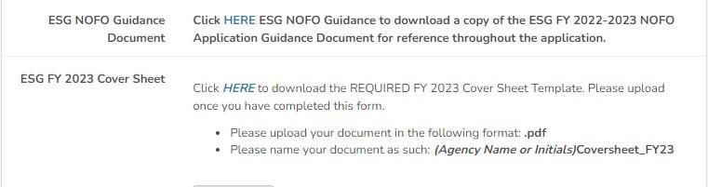
Completing the 2024 COC BUILDS LOCAL PROJECTS NOFO
Download the 2025-2026 CoC Program Local Renewal Project NOFO Guidance Document for details on the program and reference throughout the application.

Slide 36

Completing the 2024 COC BUILDS LOCAL PROJECTS NOFO
***Throughout the application, there will be several documents that you will be required to download, complete and re-upload to the application.
Click on the link to preview and download the document. Re-upload the document in the suggested document formats and with the naming convention indicated.

Slide 37
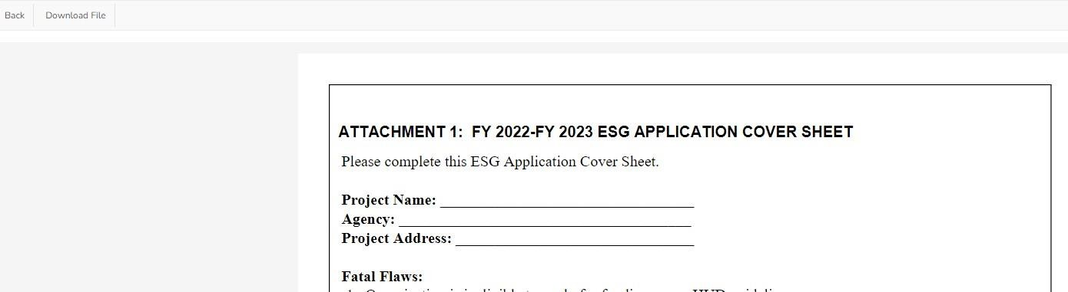


Completing the 2024 COC BUILDS LOCAL PROJECTS NOFO
Click here to download the previewed document, then click back to return to the application

Slide 38
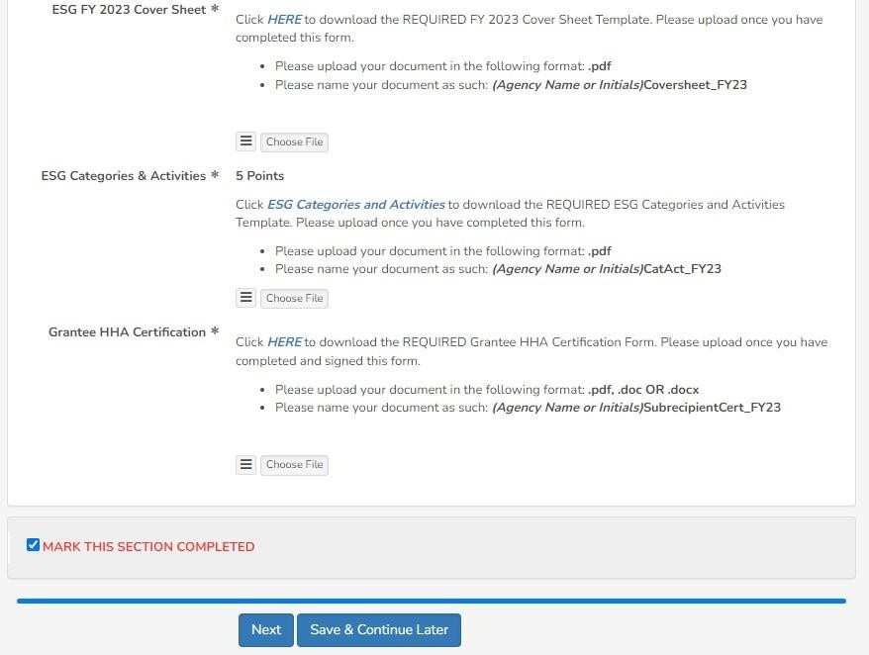


Completing the 2024 COC BUILDS LOCAL PROJECTS NOFO
At the bottom of each section of the application, you will find this checkbox and accompanying text “Mark this Section Completed.”
Check the box only after you have completed the section.
The “Save & Continue Later” button at the end of each section will take you to the application preview/ summary page. You will be able to save your application there and return to complete the application at a later time.
You can move between sections if this box is un- checked. The application will default to a checked box.
All boxes at the end of each section will need to be checked in order to submit the application
The “Next” button at the end of each section will take you to the next section of the application. The “Back” button will take you to the previous section.

Slide 39
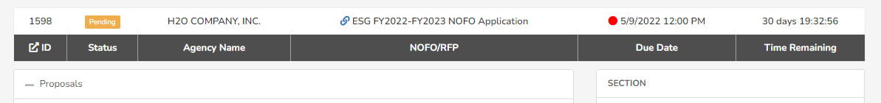

Completing the 2024 COC BUILDS LOCAL NEW PROJECTS NOFO
After you have completed the first section of the application, you will see this status bar at the top of each application section, which will include your agency name, the name of the proposal and a countdown to the application deadline date.

Slide 40
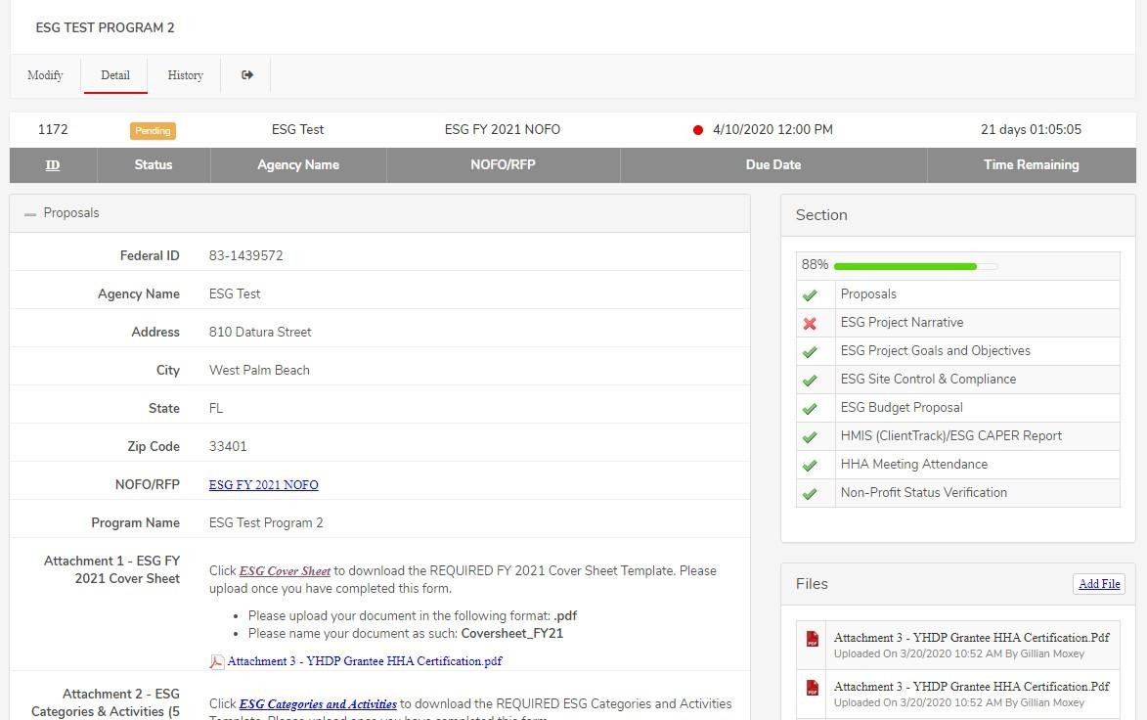
Completing the 2024 COC BUILDS LOCAL PROJECTS NOFO
Once you have pressed “Save and Continue Later,” you will be taken to the summary page, which will show all the sections of the application, as well as the status panel and all the documents you have uploaded.
If you forget to mark a section completed, you will have the opportunity to return to the application by clicking the “Modify” button, then press “Next” until you reach the section you need to mark completed. Click on the “Save and Continue Later” button to return to the summary page.

Slide 41
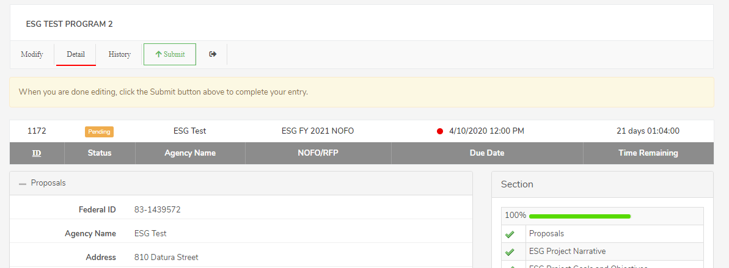
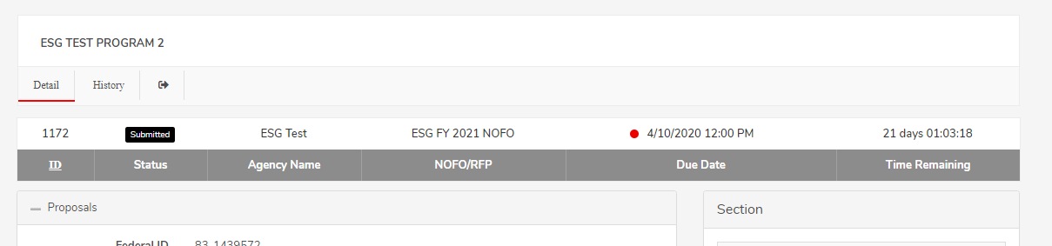
Completing the 2024 COC BUILDS LOCAL PROJECTS NOFO
On the summary page, you will have one more opportunity to review your completed application before you submit. Click on the “Submit” button to submit your application.
Note: You cannot make changes to your application once you have submitted the application
When you have submitted your application, you will see a black “Submitted” box on the status bar.

Slide 42
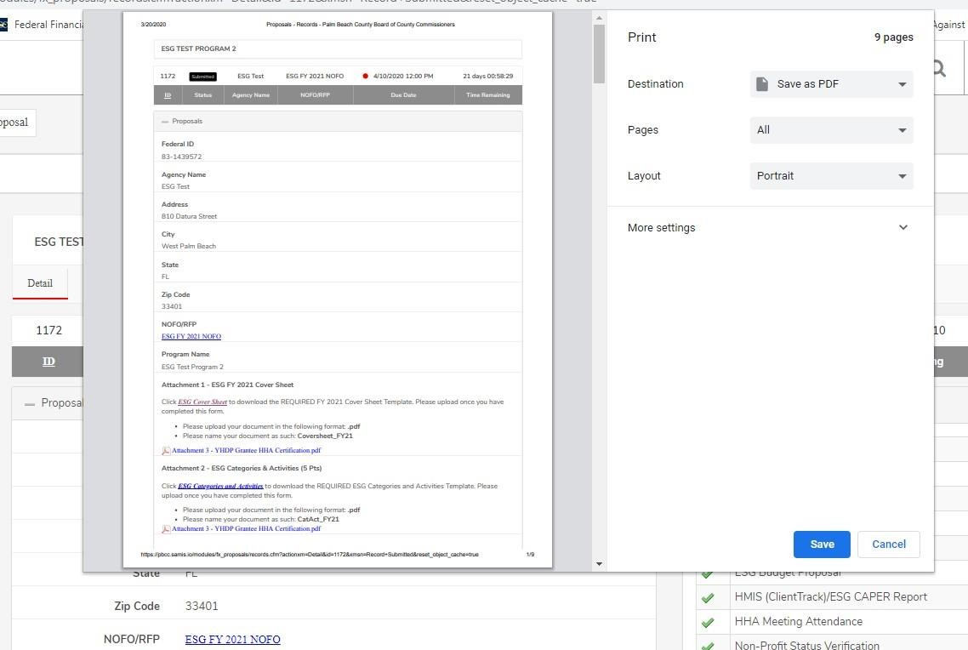
Completing the 2024 COC BUILDS LOCAL PROJECTS NOFO
You can print your application for your record by clicking the right button on your computer’s mouse

Slide 43
Completing the 2024 COC BUILDS LOCAL PROJECTS NOFO
The NOFO Invitation Code is 2024CoCBuilds

Slide 44


