Slide 1
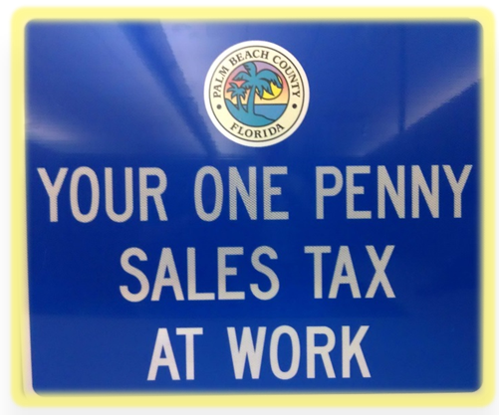
IST RESURFACING
Original 10 year plan - over 140 projects ($77.6m)
Amended (1/4/22) plan - ($94.5m)
First 6 years - 78 projects ($50m)
Completed to date - 50 projects ($31m)
  (Comprising approx. 300 lane miles)
Typical project scope:
          Milling and paving
          Restriping
          Updating curb cut ramps to latest ADA standards
          Replacing loop detection systems

Slide 2
IST BRIDGES
Original 10 year plan - 27 projects ($43.4m)
Amended (1/4/22) plan - 24 projects ($89m)
First 6 years - 21 projects
Completed to date - 2 projects ($1.65m)
Under Construction - 3 projects ($7.4m)
Under Design - 16 projects
Project scopes:
          Replace bridge with box culvert
          Rehab existing bridge structure
          Replace bridge

Slide 3
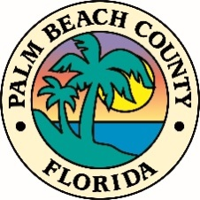
Engineering Sales Tax Projects
Original 1/2017 Modified 1/4/2022
Bridges $ 43.4 m (27) $ 89.0 m (24)
Roads (Resurfacing) $ 77.6 m (121) $ 96.0 m (117)
Roads (Restriping) $ 9.0 m (many) no change
Pathways $ 5.0 m (8) $ 6.5 m (3)
Signals & Signal Systems $ 15.0 m (17) no change
Street Lighting $ 12.0 m (many) no change
CR 880 Canal Bank Stabilization $ 5.0 m no change
Belvedere Road Canal Piping $ 1.0 m $ 1.4 m
Drainage (Pipe Repairs) $ 3.0 m (4) no change
Drainage (Improvements) $ 25.0 m (8) $ 26.1 m (8)
TOTAL $ 196.0 m $ 263.0 m
Palm Beach County Engineering and Public Works

