Slide 1
Housing Projects
IST Units #Q001 and Q009
Infrastructure Surtax independent Citizen Oversight Committee
PBC Facilities Development & Operations Department
May 19, 2022

Slide 2
Housing Units for Homeless, Extremely Low Income & Low Income (Q001)
Total IST allocation of $25.5M, accruing $2,550,000/year
Two projects initiated under this IST Unit
  Lake Village at the Glades (Pahokee)
  Prosperity Village Cottage Homes (western Lake Worth Beach)
Total collections (3/28/22) - $15,300,000
  Lake Village at the Glades - $621,000
  Prosperity Village Cottage Homes - $3.97M

Slide 3
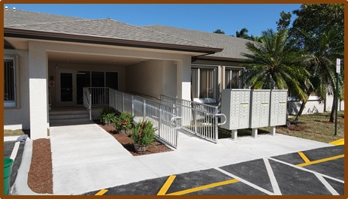
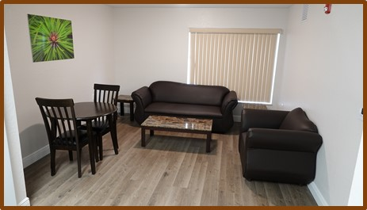
Housing Units for Homeless, Extremely Low Income & Low Income (Q001)
Lake Village at the Glades
Property acquired through foreclosure
42 individual housing units (1Bd/1Bh each)
Non-Congregate Shelter under COVID, long-term Homeless Resource Center (HRC3)
$5M CARES funds plus $620K of IST funds
Commenced operations in December 2020, formal ribbon cutting in February 2021

Slide 4
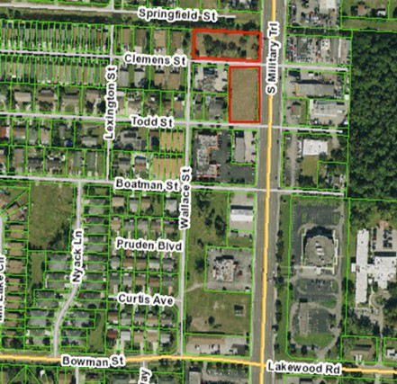
Housing Units for Homeless, Extremely Low Income & Low Income (Q001)
Prosperity Village Cottage Homes
Contract with West Palm Beach Housing Authority approved in January 2021 for the design, development and operation of a small lot housing pilot project
$3.97M IST funding
17 detached housing structures
Community Center
Ancillary parking facilities
Customary site improvements (e.g. landscaping, pedestrian and vehicular infrastructure)

Slide 5
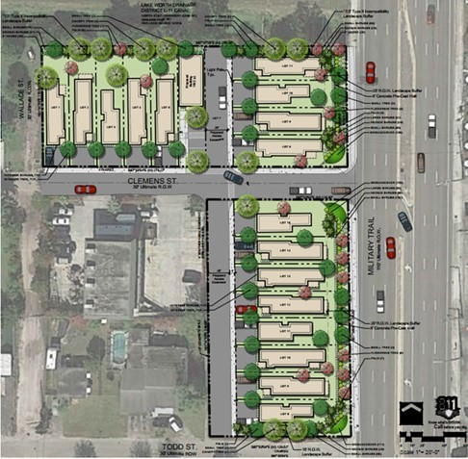
Housing Units for Homeless, Extremely Low Income & Low Income (Q001)
Prosperity Village Cottage Homes
1.36 acres, three layouts ( 2 bedroom/1 bathroom; 2 bedroom/2 bathroom; 3 bedroom/2 bathroom)
981 – 1,200 sf
$598 - $730 monthly rent
Rent shall not exceed 30% of the tenant’s gross median income. Tenants shall not earn more than 80% of area median income (AMI) for Palm Beach County.
Placement priority given to low, very low and extremely low income households on waiting lists maintained by the County (Community Services Department).
Occupancy limited to 24 months

Slide 6
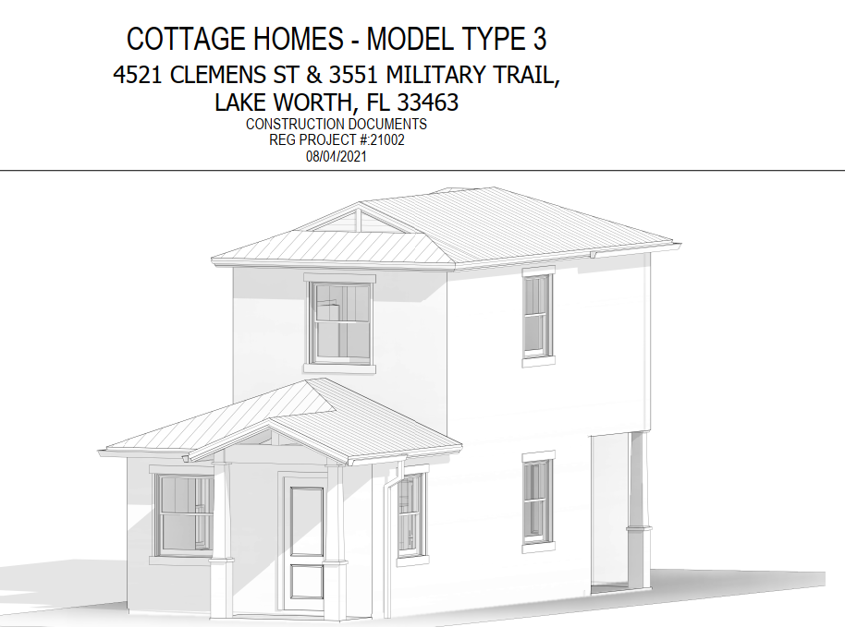
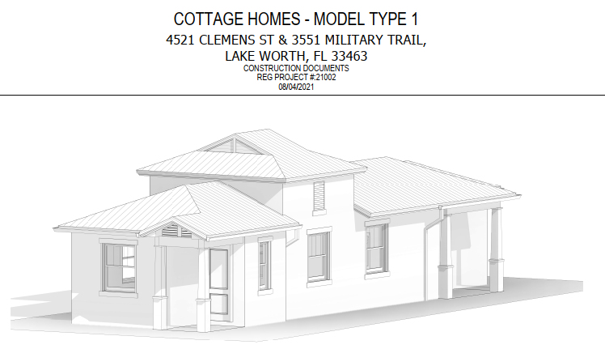
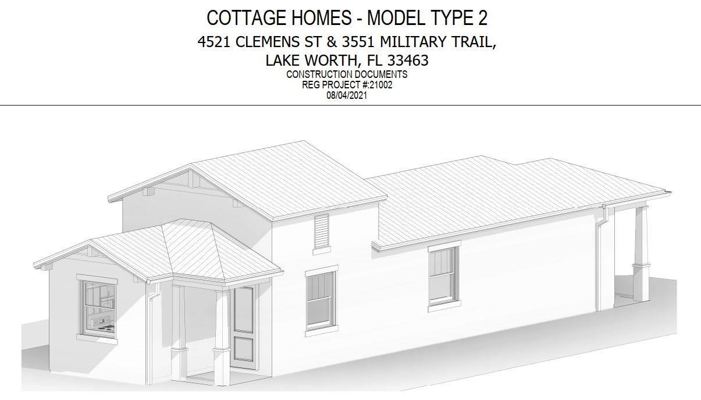
Housing Units for Homeless, Extremely Low Income & Low Income (Q001)
Prosperity Village Cottage Homes
Design and permitting completed
Bidding process underway, bids due early June
Facility opening late FY 2023

Slide 7
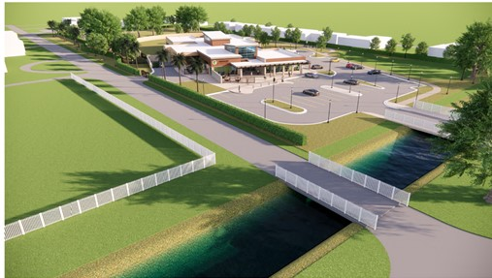
Homeless Resource Center 2 (Q009)
Update from February 2022 Presentation
Guaranteed Maximum Price (GMP) approved on March 22, 2022
Groundbreaking ceremony held on May 9, 2022
14 months of construction ahead, opening in late FY2023

Slide 8
Questions

