Slide 1

Acreage Community Park Improvements
Acreage Community Park consists of 45 total acres. ITID has a long-term land-lease agreement with PBC on 28 acres to construct and operate a park for the residents of the Acreage.
$3M in Surtax funding was approved in 2016 for the construction of a community/recreation center within Acreage Community Park.
Since 2016, recreational needs within the Acreage have changed and there is a more immediate need for additional outdoor recreation amenities.
Proposed New Project Scope: Construction of a Synthetic Turf Multipurpose Field, Skate Park, Equestrian Drop Off Area and support infrastructure.

Slide 2
Acreage Community Park Improvements
On April 27th the ITID Board approved Resolution # 2022-010 requesting the funding be reallocated to fund these needed recreational amenities.
Latest cost estimate is $2.995M

Slide 3
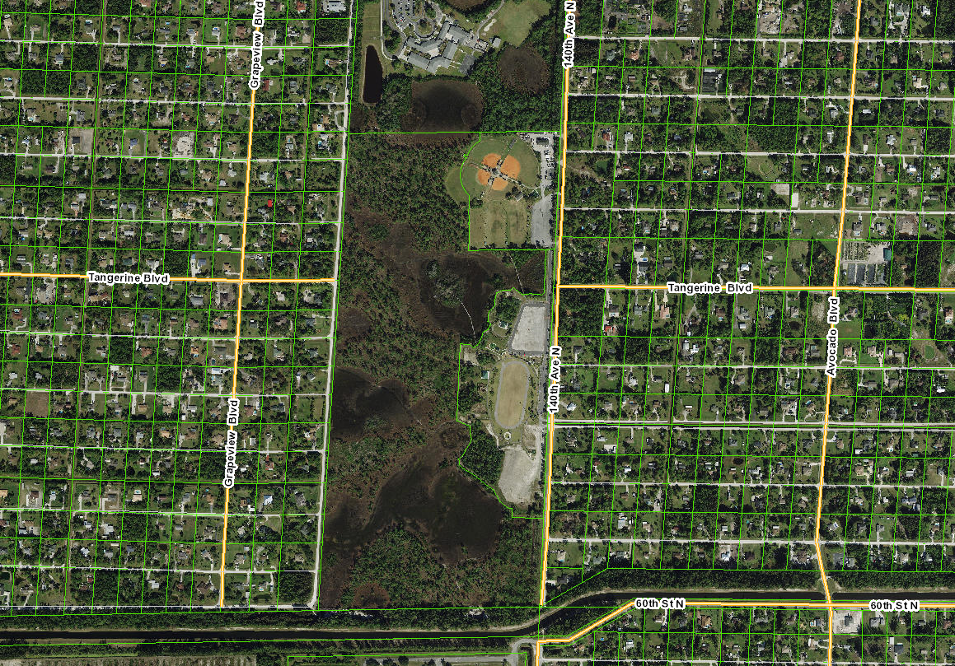
Acreage Community Park

Slide 4
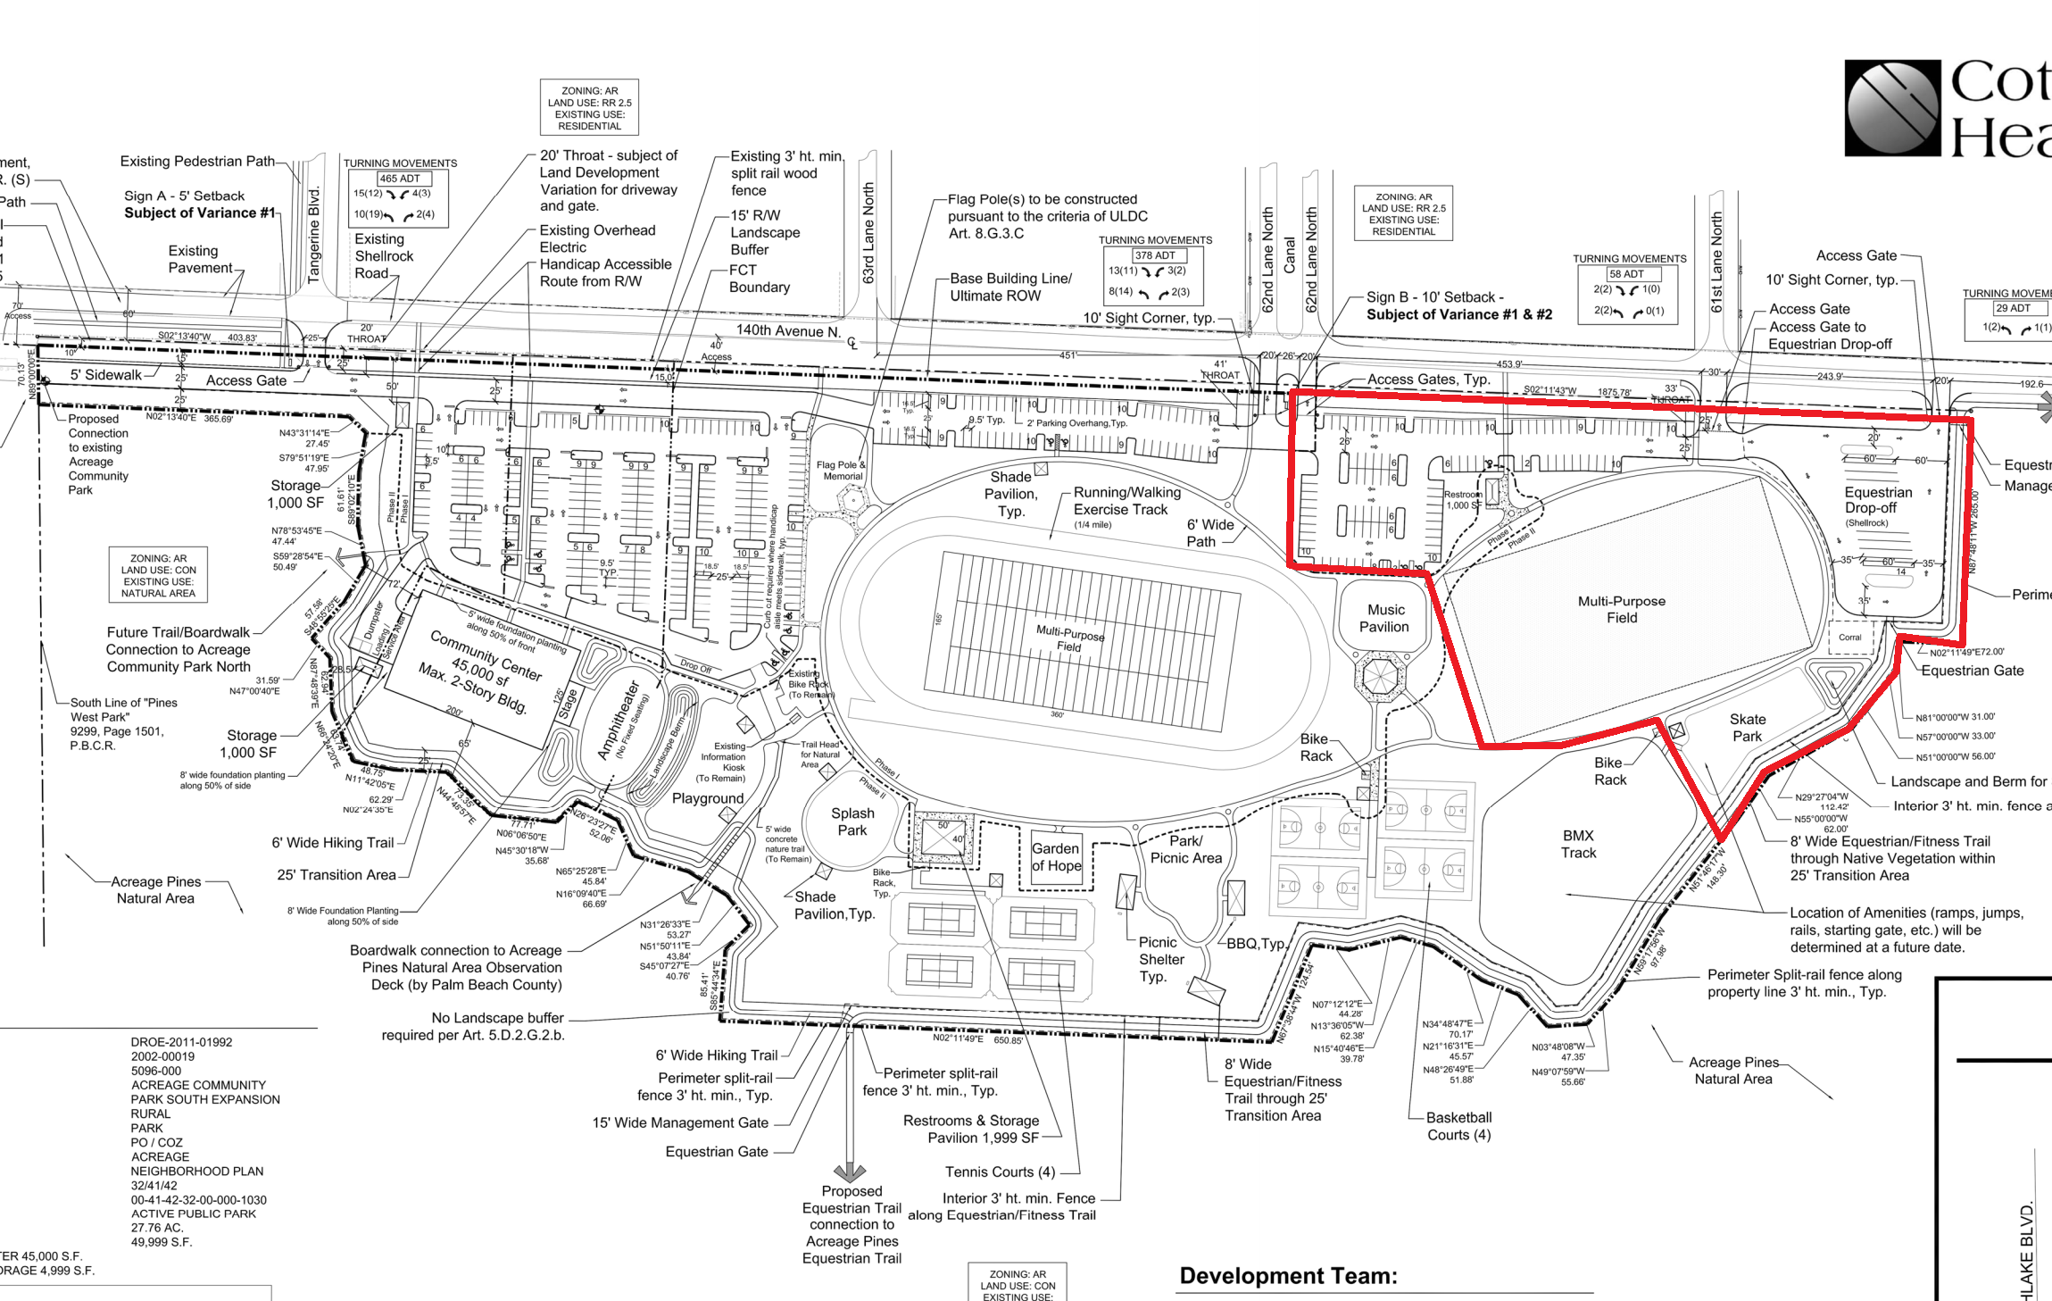
Acreage Community Park Proposed Improvements

Slide 5
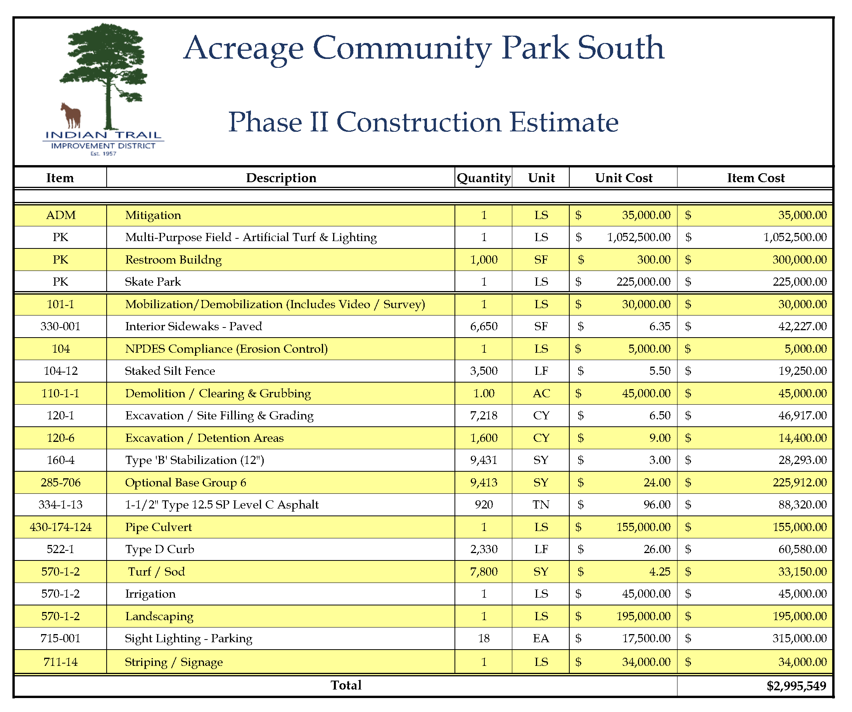
Acreage Community Park Cost Estimate

