Slide 1
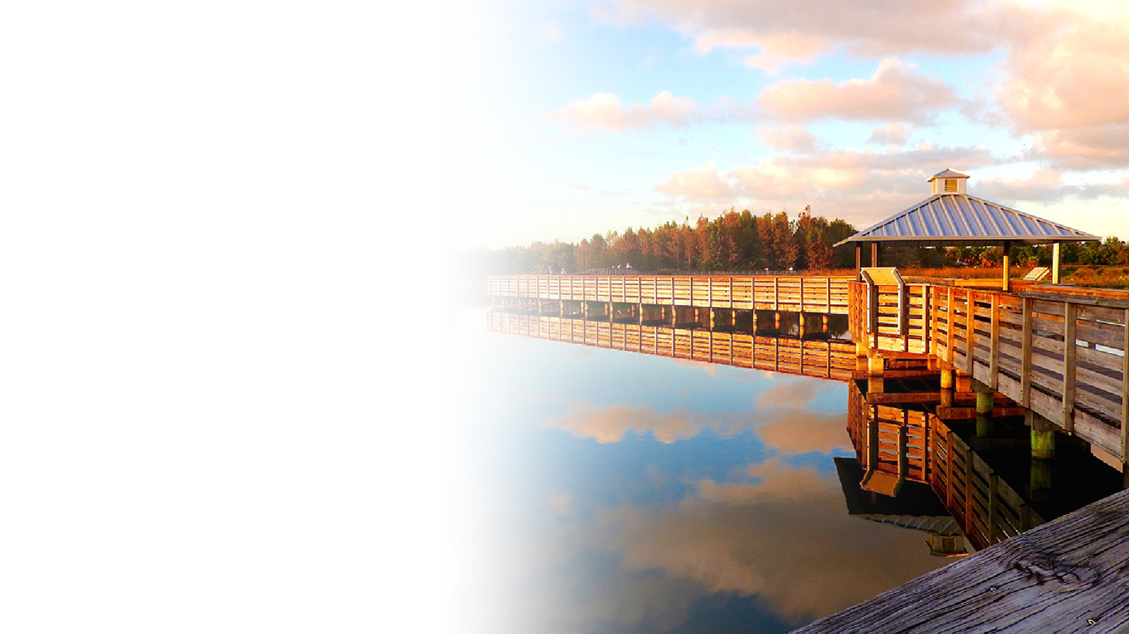


Palm Beach County
Impact Fee Update Study
June 10, 2022

Slide 2
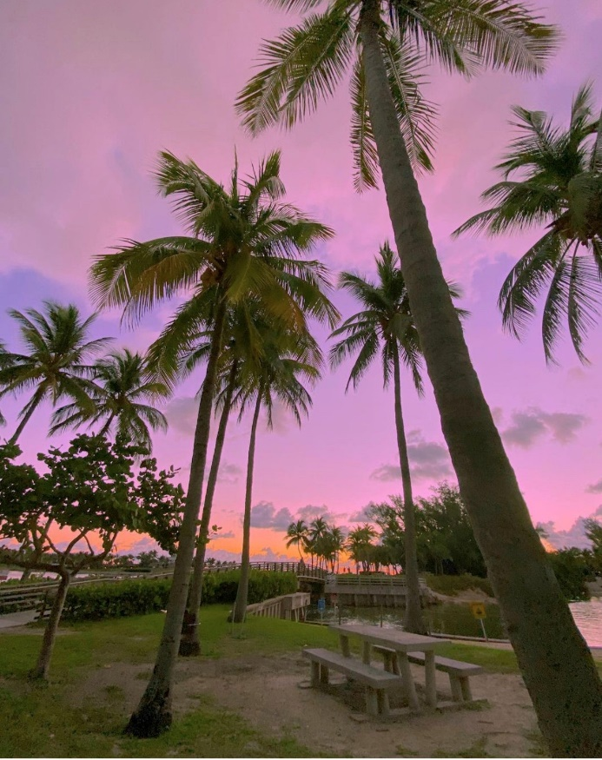
Presentation Overview
Background/Purpose
Technical Study
  Transportation
  School Facilities
  Library Facilities
  Fire Rescue
  Public Buildings
  Parks & Recreation Facilities
  Law Enforcement
Next Steps

Slide 3
Background/Purpose
Palm Beach County:
  3rd largest county in population out of 67 counties (1.5 million)
  5th in terms of absolute population growth
    Projected to add 337,000 residents through 2050 (BEBR, February 2022)
  30th in terms of population growth rate (BEBR, February 2022)
    (1.1% per year through 2025 & 0.7% through 2050)
  7th in terms of residential permitting levels (US Census, 2021)
Implemented impact fees in 1988
Last updated in 2014-2018
  Most fees remained at 2012-study levels

Slide 4
Background/Purpose
Technical study update started in February 2021
Presented initial study findings on April 1, 2022
Reviewed law enforcement impact fee calculations and revised fire rescue impact fee calculations on April 22, 2022
Recommendations discussed on May 6, 2022:
  Acceptance of roads, schools and library fees as presented on April 1st.
  Acceptance of fire rescue impact fee as presented on April 22nd.
  Acceptance of parks impact fee calculations without land value.
  Acceptance of public buildings impact fee calculations without jail facilities.
  Additional data/information for law enforcement impact fee.

Slide 5
Presentation Overview
Background/Purpose
Technical Study
  Transportation
  School Facilities
  Library Facilities
  Fire Rescue
  Public Buildings
  Parks & Recreation Facilities
  Law Enforcement
Next Steps

Slide 6

Transportation

Slide 7
Transportation
Calculated Impact Fee:
Land Use | Unit | Fully Calculated Impact Fee | Current Adopted Impact Fee | HB 337 Capped Impact Fee*
Residential
Single Family (2,000 sq ft) | du | $5,892 | $4,717 | $5,892
Non-Residential
Light Industrial | 1,000 sf | $2,633 | $1,522 | $2,283
Office | 1,000 sf | $5,847 | $3,418 | $5,127
Retail (Commercial/Shopping Center) | 1,000 sfgla | $8,323 | $7,656 | $8,323
*Over the next four years

Slide 8
Transportation
Impact Fee Component Changes:
Input Variable | 2018 Study (Partially Adopted)* | 2021 Study | % Change
Single Family (per du)
Net Vehicle-Miles of Travel | 18.30 | 16.85 | -8%
Cost per Lane Mile | $3,622,000 | $5,559,000 | +53%
Capacity Added per Lane Mile | 11,533 | 14,000 | +21%
Cost per Vehicle-Mile of Capacity | ≈$314 | ≈$397 | +26%
County/State Credit | $783 | $801 | +2%
Calculated Impact Fee | $4,965 | $5,892 | +19%
*Full calculated rate is shown for comparison purposes. Fee was adopted at 95% ($4,717)

Slide 9
Transportation
Impact Fee Comparison
Land Use | Unit | Palm Beach County | Martin County | Broward County | Glades County | Miami-Dade County | St. Lucie County | Collier County | Highlands County | Orange County URBAN | Hillsborough County URBAN
Study Date | - | 2022 | 2020 | n/a | 2008 | 2006 | 2017/19 | 2019 | 2006 | 2020 | 2020
Assessed Portion | - | N/A | 100% | n/a | 100% | 100% | 100% | 87-100% | 25% | 100% | 80%
Single Family (2,000 sf) | du | $5,892 | $5,516 | $431 | $5,716 | $9,819 | $5,130 | $7,870 | $1,649 | $8,218 | $7,346
Light Industrial | 1,000 sf | $2,633 | $2,729 | $482 | $3,644 | $3,965 | $1,103 | $4,584 | $1,166 | $3,117 | $3,384
Office (50k sq ft) | 1,000 sf | $5,847 | $5,366 | $445 | $4,831 | $15,999 | $3,718 | $8,605 | $3,095 | $8,132 | $6,669
Retail (100k sq ft) | 1,000 sfgla | $8,323 | $8,503 | $410 | $8,636 | $20,824 | $6,341 | $13,774 | $2,455 | $11,052 | $10,850

Slide 10
Transportation
Revenue Projections
  Based on permitting levels from 2015+
    Full calculated rates ≈$24.3 million per year
  Examples of projects eligible for impact fee funding
    Lane additions
    Intersection improvements

Slide 11
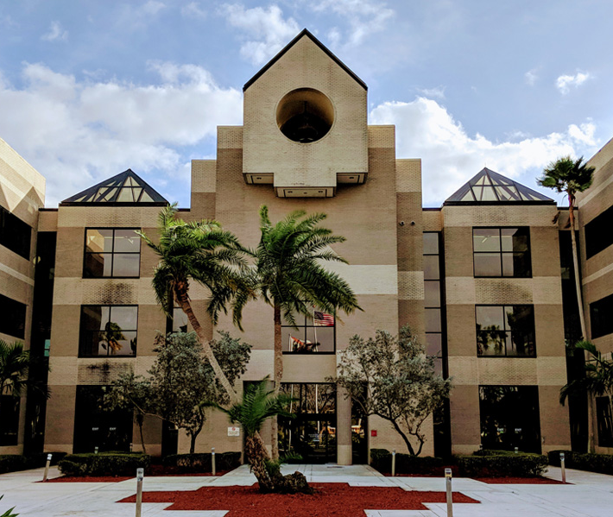
School Facilities

Slide 12
School Facilities
Calculated School Impact Fee Rates
Residential Land Use | Unit | Students per Unit | Net Impact Cost per Student | Fully Calculated Fee | Current Adopted Fee | HB 337 Capped Fee*
Residential
800 sf & Under | du | 0.259 | $28,306 | $7,331 | $2,362 | $3,543
801 to 1,399 sf | du | 0.310 | $28,306 | $8,775 | $4,330 | $6,495
1,400 to 1,999 sf | du | 0.286 | $28,306 | $8,096 | $6,153 | $8,096
2,000 to 3,599 sf | du | 0.294 | $28,306 | $8,322 | $6,608 | $8,322
3,600 sf or more | du | 0.226 | $28,306 | $6,397 | $6,506 | $6,397
*Over the next four years

Slide 13
School Facilities
Impact Fee Component Changes since 2014-18 Study:
Input Variable | 2014-18 Study (Adopted @95%) | 2021 Study | % Change
Residential 2,000 – 3,599 sf (per du)
Total Impact Cost per Student | $28,338 | $33,273 | +17%
Total Credit per Student | $6,531 | $4,967 | -24%
Net Impact Cost per Student | $21,807 | $28,306 | +30%
Student Generation Rate per Unit | 0.319 | 0.294 | -8%
Calculated Impact Fee | $6,956 | $8,322 | +20%

Slide 14
School Facilities
School Impact Fee Rate Comparison
Residential Land Use | Date of Last Update | Adoption % | Single Family Rate | SFR Rate @ 100%
Miami-Dade County | 1995 | 100% | $2,448 | $2,448
Marion County* | 2006 | 100% | $3,967 | $3,516
Citrus County | 2021 | 40% | $1,660 | $4,117
Volusia County | 2013 | 66% | $2,942 | $4,483
Indian River County | 2020 | 28% | $1,310 | $4,680
St Johns County | 2018 | 100% | $5,016 | $4,725
Flagler County | 2004 | 76% | $3,600 | $4,756
Nassau County | 2017 | 100% | $5,431 | $5,431
St Lucie County | 2009 | 100% | $6,786 | $5,447
All fees charged per dwelling unit; rate shown for 2,000 sf single family tier
*Fees suspended until January 2023

Slide 15
School Facilities
School Impact Fee Rate Comparison
Residential Land Use | Date of Last Update | Adoption % | Single Family Rate | SFR Rate @ 100%
Lee County | 2018 | 53% | $2,879 | $5,484
Martin County | 2012 | 100% | $5,567 | $5,567
Manatee County | 2017 | 100% | $6,127 | $6,127
Hernando County | 2019 | 50% | $3,167 | $6,352
Palm Beach County - Adopted | 2014-1 | 95% | $6,608 | $6,956
Sarasota County | 2015 | 26% | $2,032 | $7,835
Hillsborough County | 2020 | 100% | $8,227 | $8,227
Palm Beach County - Calculated | 2021 | N/A | N/A | $8,322
Lake County | 2019 | 100% | $8,927 | $8,927

Slide 16
School Facilities
School Impact Fee Rate Comparison
Residential Land Use | Date of Last Update | Adoption % | Single Family Rate | SFR Rate @ 100%
Pasco County | 2017 | 79% | $7,128 | $9,028
Broward County | 2017 | 74% | $7,047 | $9,516
Clay County | 2009 | 77% | $7,034 | $9,096
Orange County | 2020 | 96% | $9,148 | $9,513
Brevard County | 2015 | 50% | $5,097 | $10,193
Collier County | 2015 | 67% | $8,790 | $11,164
Seminole County | 2017 | 73% | $9,000 | $12,322
Osceola County | 2017 | 100% | $11,823 | $11,823

Slide 17
School Facilities
Revenue Projections
  Based on permitting levels from 2015+
    Full calculated rates ≈$32.2 million per year
    HB 337 capped rates ≈$28.4 million per year
  Examples of projects eligible for impact fee funding
    Scripps/Gardens Area ES: $30 million
    West Acreage Area ES: $30 million
    Western Communities HS: $93 million
    West Delray Area ES: $42 million

Slide 18
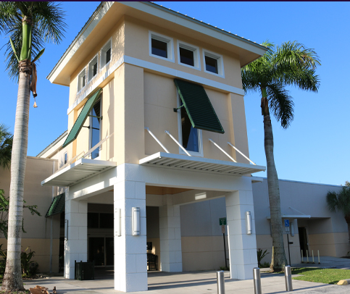
Library Facilities

Slide 19
Library Facilities
Calculated Impact Fee
Residential Land Use | Unit | Residents per Unit | Fully Calculated Fee | Current Adopted Fee | HB 337 Capped Fee*
Residential
800 sq ft & Under | du | 1.49 | $181 | $125 | $181
801 – 1,399 sq ft | du | 2.05 | $249 | $186 | $249
1,400 – 1,999 sq ft | du | 2.33 | $283 | $212 | $283
2,000 – 3,599 sq ft | du | 2.56 | $311 | $243 | $311
3,600 & Over sq ft | du | 2.75 | $334 | $267 | $334
*Over the next four years

Slide 20
Library Facilities
Impact Fee Component Changes since 2014-18 Study:
Input Variable | 2014-18 Study (Not Adopted) | 2021 Study | % Change
Residential 2,000 – 3,599 sf (per du)
Total Impact Cost per Resident | $182 | $191 | +5%
Total Credit per Resident | $70 | $69 | -2%
Net Impact Cost per Resident | $112 | $122 | +5%
Residents per Unit | 2.40 | 2.56 | +7%
Calculated Impact Fee | ≈$266 | $311 | +16%

Slide 21
Library Facilities
Impact Fee Comparison
Land Use | Unit | Palm Beach County |  |  | Collier County | Martin County | St. Lucie County
Land Use | Unit | Current Adopted | Fully Calculated | HB 337 Capped* | Collier County | Martin County | St. Lucie County
Study Date | - | 2012 | 2021 | N/A | 2016 | 2012 | 2017
Assessed Portion | - | 75% | N/A | N/A | 100% | 100% | 100%
Residential
Single Family (2,000 sf) | du | $243 | $311 | $311 | $336 | $537 | $276
Multi-Family (1,300 sf) | du | $186 | $249 | $249 | $160 | $537 | $192
Mobile Home (1,300 sf) | du | $186 | $249 | $249 | $270 | $537 | $174
*Over the next four years

Slide 22
Library Facilities
Revenue Projections
  Based on permitting levels from 2015+
    Full calculated/HB 337 capped rates ≈$0.9 million per year
  Examples of projects eligible for impact fee funding
    Canyon Branch Library: $20.6 million

Slide 23
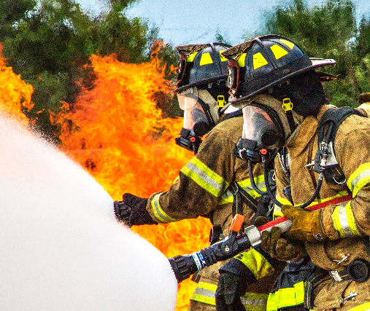
Fire Rescue

Slide 24
Fire Rescue
Calculated Impact Fee
Land Use | Unit | Calls for Service Coefficient* | Fully Calculated Fee (Revised) | Fully Calculated Fee (Original) | Current Adopted Fee | HB 337 Capped Fee**
Residential
Single Family (attached/detached/mobile home) | du | 0.2821 | $628 | $852 | $276 | $414
Multi-Family | du | 0.1717 | $382 | $518 | $185 | $277
Non-Residential
General Industrial | 1,000 sf | 0.0673 | $154 | $193 | $80 | $120
Office | 1,000 sf | 0.0370 | $85 | $114 | $50 | $75
General Retail | 1,000 sfgla | 0.0749 | $172 | $235 | $121 | $172
* Average of 2016-2019, 2021
**Over the next four years

Slide 25
Fire Rescue
Impact Fee Component Changes:
Input Variable | 2014-18 Study* | 2021 Study Revised | % Change
Single Family (per du)
Total Impact Cost per Incident | $1,285 | $2,389 | +86%
Total Credit per Incident | $165 | $163 | -1%
Net Impact Cost per Incident | $1,119 | $2,226 | +99%
Calls for Service Coefficient | 0.2601 | 0.2821 | +8%
Calculated Impact Fee | $291 | $628 | +116%
*Full calculated rate is shown for comparison purposes. Fee was adopted at 95% ($276)

Slide 26
Fire Rescue
Impact Fee Comparison
Land Use | Unit | Palm Beach County |  |  | Hillsborough County | Martin County | Miami-Dade County | Orange County | St Lucie County
Land Use | Unit | Current Adopted | Fully Calculated | HB 337 Capped* | Hillsborough County | Martin County | Miami-Dade County | Orange County | St Lucie County
Study Date | - | 2014-2018 | 2021 | N/A | 2018 | 2012 | N/A | 2017 | 2016
Assessed Portion | - | 95% | N/A | N/A | 100% | 100% | N/A | 100% | 100%
Residential
Single Family (2,000 sf) | du | $276 | $628 | $414 | $335 | $599 | $447 | $339 | $667
Multi-Family (1,300 sf) | du | $185 | $382 | $277 | $249 | $599 | $447 | $232 | $436
Non-Residential
General Industrial | 1,000 sf | $80 | $154 | $120 | $57 | $12 | $1,448 | $84 | $76
Office | 1,000 sf | $50 | $85 | $75 | $158 | $80 | $355 | $269 | $668
Retail | 1,000 sfgla | $121 | $172 | $172 | $313 | $319 | $478 | $307 | $536
*Over the next four years

Slide 27
Fire Rescue
Revenue Projections
  Based on permitting levels from 2015+
    Full calculated rates ≈$1.3 million per year
    HB 337 capped rates ≈$0.9 million per year
  Examples of projects eligible for impact fee funding
    Agricultural Reserve North Fire Station (≈$7 M)
    Agricultural Reserve South Fire Station (≈$6.2 M)
    Southern Blvd 20 Mile Bend Station (≈$7.3 M)

Slide 28
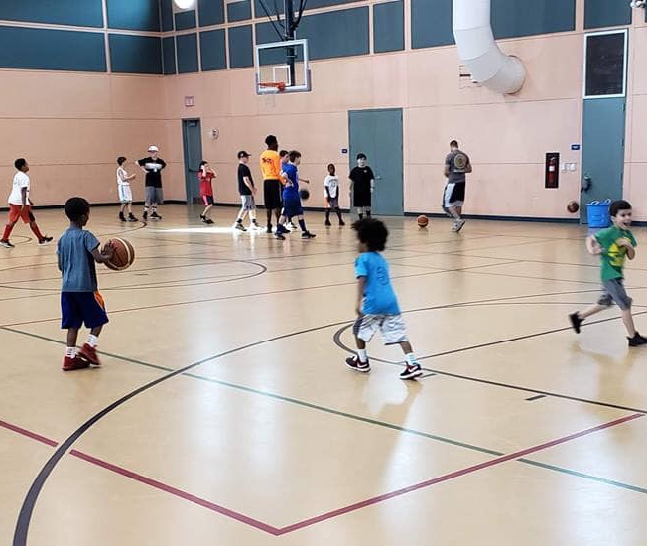
Parks & Recreation

Slide 29
Parks & Recreation
Calculated Impact Fee
Residential Land Use | Unit | Residents per Unit | Fully Calculated Fee | Calculated Fee (Excl. Beach) | Calculated Fee (Excl. Land) | Current Adopted Fee
Residential
800 sq ft & Under | du | 1.43 | $1,732 | $1,361 | $860 | $366
801 – 1,399 sq ft | du | 1.96 | $2,374 | $1,865 | $1,179 | $734
1,400 – 1,999 sq ft | du | 2.23 | $2,701 | $2,122 | $1,341 | $788
2,000 – 3,599 sq ft | du | 2.45 | $2,967 | $2,332 | $1,474 | $860
3,600 & Over sq ft | du | 2.63 | $3,185 | $2,503 | $1,582 | $818
Transient, Assisted Group
Hotel/Motel | du | 1.47 | $1,799 | $1,408 | $893 | $273
Congregate Living Facility | du | 0.84 | $1,028 | $804 | $510 | $273

Slide 30
Parks & Recreation
Calculated Impact Fee
Residential Land Use | Unit | Calculated Fee (Excl. Land) | Current Adopted Fee | HB 337 Capped Fee*
Residential
800 sq ft & Under | du | $860 | $366 | $549
801 – 1,399 sq ft | du | $1,179 | $734 | $1,101
1,400 – 1,999 sq ft | du | $1,341 | $788 | $1,182
2,000 – 3,599 sq ft | du | $1,474 | $860 | $1,290
3,600 & Over sq ft | du | $1,582 | $818 | $1,227
Transient, Assisted Group | du
Hotel/Motel | du | $893 | $273 | $409
Congregate Living Facility | du | $510 | $273 | $409
*Over the next four years

Slide 31
Parks & Recreation
Impact Fee Component Changes since 2014-18 Study:
Input Variable | 2014-18 Study (Not Adopted) | 2021 Study (Excl Land) | % Change
Residential 2,000 – 3,599 sf (per du)
Total Impact Cost per Resident | $466 | $645 | +38%
Total Credit per Resident | $40 | $43 | +8%
Net Impact Cost per Resident | $426 | $602 | +41%
Residents per Unit | 2.30 | 2.45 | +7%
Calculated Impact Fee | ≈$979 | $1,474 | +50%

Slide 32
Parks & Recreation
Impact Fee Comparison
Land Use | Unit | Palm Beach County |  |  | Broward County | Collier County | Hillsborough County | Martin County
Land Use | Unit | Current Adopted | Calculated (Excl. Land) | HB 337 Capped* | Broward County | Collier County | Hillsborough County | Martin County
Study Date | - | 2012 | 2021 | N/A | N/A | 2016 | 2020 | 2012
Assessed Portion | - | 95% | N/A | N/A | N/A | 100% | 55% | 100%
Residential
Single Family (2,000 sq ft) | du | $860 | $1,474 | $1,290 | $519 | $3,628 | $1,815 | $1,972
Multi-Family (1,300 sq ft) | du | $734 | $1,179 | $1,101 | $371 | $1,685 | $1,447 | $1,972
Mobile Home (1,300 sq ft) | du | $734 | $1,179 | $1,101 | $528 | $2,862 | $1,447 | $1,972
*Over the next four years

Slide 33
Parks and Recreation
Impact Fee Comparison (continued)
Land Use | Unit | Palm Beach County |  |  | Miami-Dade County | St. Lucie County | Orange County
Land Use | Unit | Current Adopted | Calculated (Excl. Land) | HB 337 Capped* | Miami-Dade County | St. Lucie County | Orange County
Study Date | - | 2012 | 2021 | N/A | N/A | 2017 | 2017
Assessed Portion | - | 95% | N/A | N/A | N/A | 100% | 100%
Residential
Single Family (2,000 sq ft) | du | $860 | $1,474 | $1,290 | $2,613-$4,154 | $1,707 | $1,721
Multi-Family (1,300 sq ft) | du | $734 | $1,179 | $1,101 | $1,619-$2,439 | $1,523 | $1,165
Mobile Home (1,300 sq ft) | du | $734 | $1,179 | $1,101 | $2,613-$4,154 | $1,118 | $1,283
*Over the next four years

Slide 34
Parks and Recreation
Review of Benefit Districts:
  Based on:
    Geographic boundaries
    Location of existing parks & future projects
    Impact fee revenue and expenditure distribution
    Visitation data from Palm Beach County
  Recommendations:
    From Three to Two districts

Slide 35
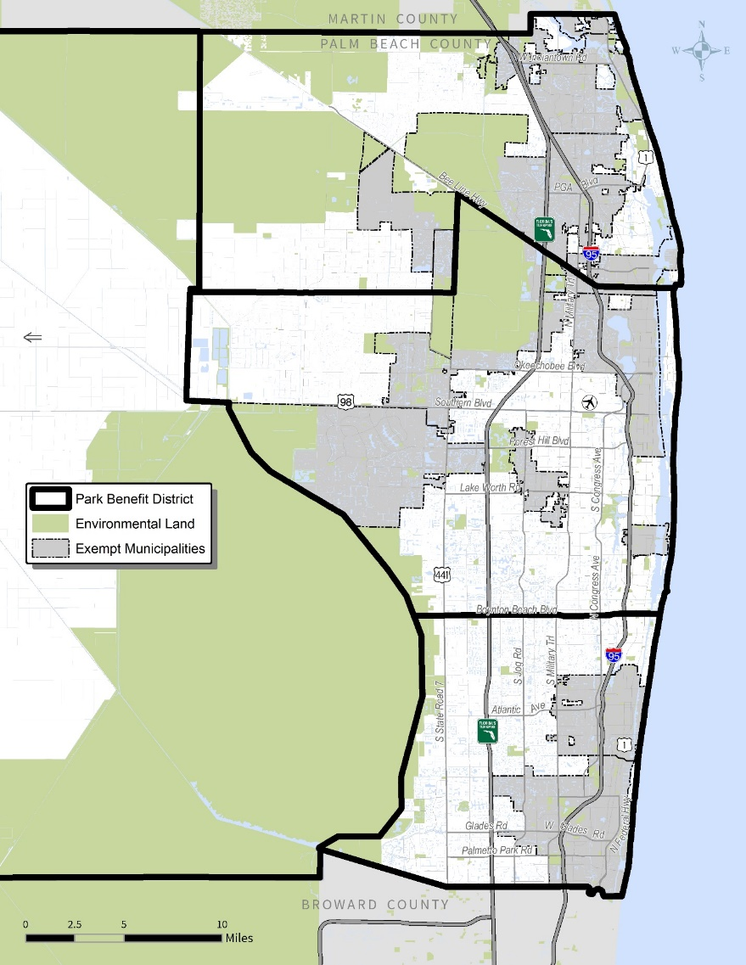
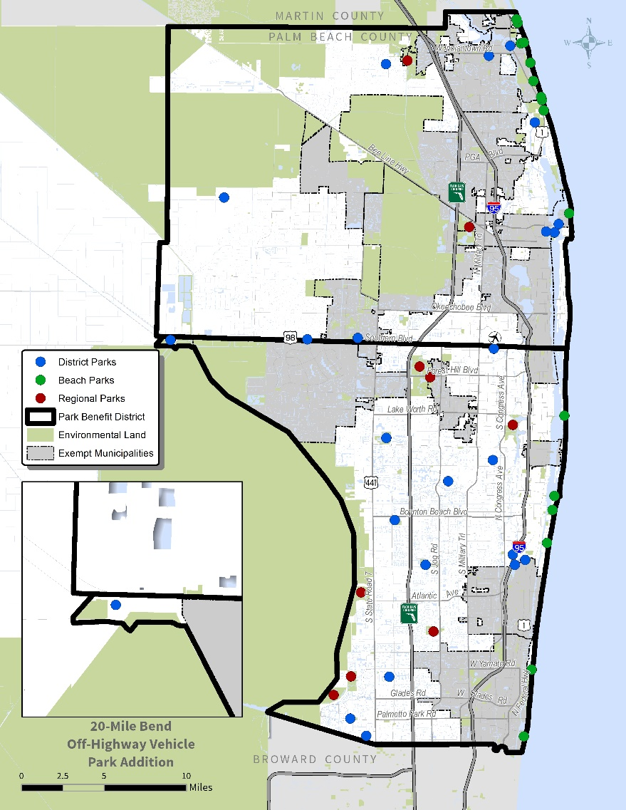
Parks & Recreation
Existing Parks & Rec Benefit Zones
Proposed Parks & Rec Benefit Zones
Zone 1
Zone 1
Zone 2
Zone 2
Zone 3

Slide 36
Parks and Recreation
Revenue Projections
  Based on permitting levels from 2015+
    Full calculated rates ≈$10.2 million per year
    HB 337 capped rates ≈$4.6 million per year

Slide 37
Parks and Recreation
Revenue Projections
  Examples of projects eligible for impact fee funding
    Villages of Windsor Park: $8 million
    Milani Park: $3 million
    West Delray Regional Expansion: $2 million
    Okeeheelee South Phase 3 Development: $25 million
    John Prince Park Mound Circle Phase 2: $2.2 million
    Karen Marcus Preserve Park: $15 million
    Lantana District “I” Property: $15 million
    Sansbury Way Property: $15 million

Slide 38
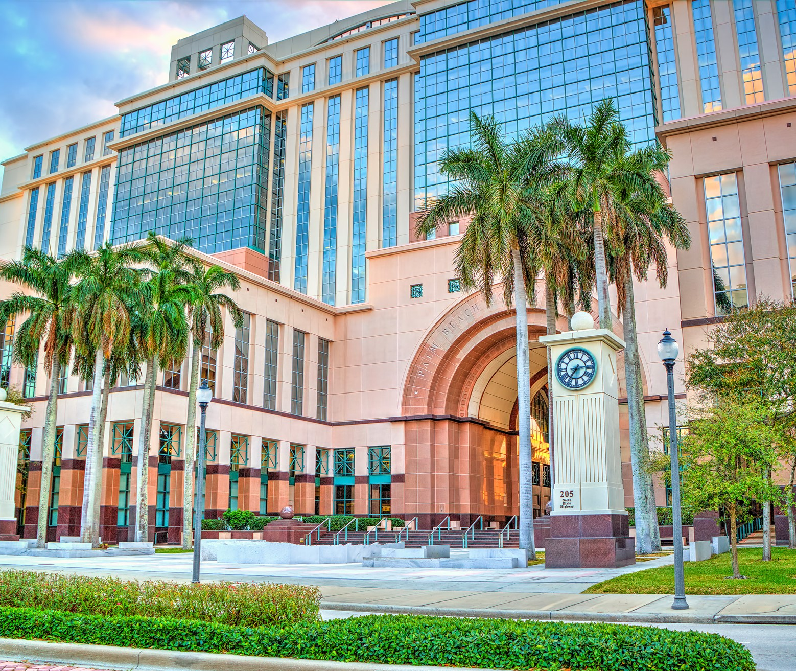
Public
Buildings

Slide 39
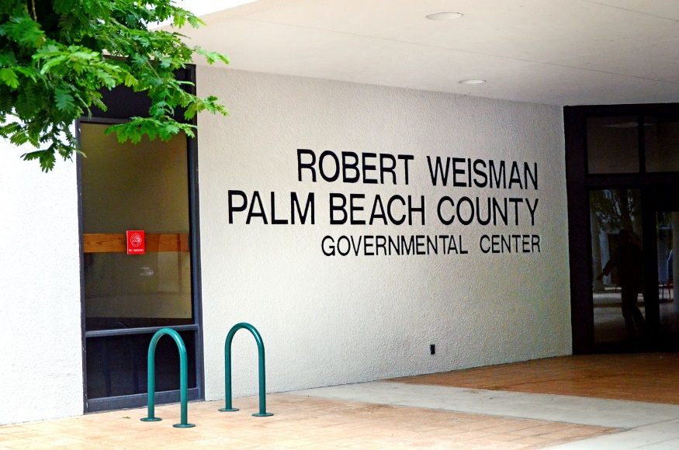
Public Buildings
Inventory
  General Government Buildings
    ≈6.5 M vs. 5.2M total square feet
      Office & administrative: 2.1 M sf
      Courthouse: 954,000 sf
      Jail: 1.3 M sf
      Industrial: 464,000 sf
      Industrial support: 1.7 M sf
    ≈620 acres of land (462 acres excluding jail acreage)
  Unit Costs:
    Buildings: $248 per square foot (range from $55 per sf to $400 per sf)
    Land: $200,000 per acre

Slide 40
Public Buildings
Level of Service
Service Area: Countywide
Variable | All Buildings | Excluding Jail
Functional Population (Countywide) | 1,567,886
Public Buildings Square Footage (Primary Bldgs) | 6,518,792 | 5,210,845
Achieved LOS (Square Feet per Resident) | 4.16 | 3.32

Slide 41
Public Buildings
Cost Component
Variable | All Public Buildings | Public Buildings Excl. Jail
Building Value | $1.639 B | $1.214 B
Land Value | $0.124 B | 0.092 B
Total Asset Value | ≈$1.763 B | $1.307 B
Service Area Population | 1,567,886
Total Impact Cost per Functional Resident | ≈$1,125 | ≈$832

Slide 42
Public Buildings
Net Impact Cost
Variable | All Buildings | Excluding Jail
Impact Cost
Total Impact Cost per Functional Resident | $1,125 | $832
Revenue Credit
Total Credit per Functional Resident
- Residential Land Uses | $161
- Non-Residential Land Uses | $156
Net Impact Cost
Net Impact Cost per Functional Resident
- Residential Land Uses | $964 | $671
- Non-Residential Land Uses | $969 | $676

Slide 43
Public Buildings
Calculated Impact Fee
Land Use | Unit | Functional Residents Per Unit | Calculated Fee (All Bldgs) | Calculated Fee (Excl. Jail) | Current Adopted Fee (2012)* | HB 337 Capped Fee**
Residential
801 to 1,399 sf | du | 1.31 | $1,263 | $879 | $171 | $256
2,000 to 3,599 sf | du | 1.63 | $1,572 | $1,094 | $223 | $334
Non-Residential
Light Industrial | 1,000 sf | 0.48 | $465 | $325 | $74 | $111
Office | 1,000 sf | 0.98 | $950 | $663 | $131 | $196
Retail/Shopping Center (40K-150K sfgla) | 1,000 sfgla | 2.58 | $2,502 | $1,745 | $336 | $504
* Based on 2012 study, adopted at 27%
** Over the next four years

Slide 44
Public Buildings
Impact Fee Component Changes since 2014-18 Study:
Input Variable | 2014-18 Study (Not Adopted) | 2021 Study (All Bldgs) | % Change
Residential 2,000 – 3,599 sf (per du)
Total Impact Cost per Functional Resident | $1,014 | $1,126 | +11%
Total Credit per Functional Resident | $197 | $161 | -18%
Net Impact Cost per Functional Resident | $817 | $965 | +11%
Functional Residents per Unit | 1.56 | 1.63 | +4%
Calculated Impact Fee | ≈$1,275 | $1,573 | +23%

Slide 45
Public Buildings
Impact Fee Component Changes since 2014-18 Study:
Input Variable | 2014-18 Study (Not Adopted) | 2021 Study (Excl. Jail) | % Change
Residential 2,000 – 3,599 sf (per du)
Total Impact Cost per Functional Resident | $1,014 | $832 | -18%
Total Credit per Functional Resident | $197 | $161 | -18%
Net Impact Cost per Functional Resident | $817 | $671 | -18%
Functional Residents per Unit | 1.56 | 1.63 | +4%
Calculated Impact Fee | ≈$1,275 | $1,094 | -14%

Slide 46
Public Buildings
Impact Fee Comparison
Land Use | Unit | Palm Beach County |  |  |  | Collier County | Martin County | St. Lucie County
Land Use | Unit | Current Adopted | Calculated (All Bldgs) | Calculated (Excl. Jail) | HB 337 Capped* | Collier County | Martin County * | St. Lucie County
Study Date | - | 2012 | 2021 | 2021 | N/A | 2016 | 2012 | 2017
Assessed Portion | - | 27% | N/A | N/A | N/A | 100% | 100% | 100%
Residential
Single Family (2,000 sf) | du | $223 | $1,573 | $1,094 | $334 | $934 | $646 | $365
Multi-Family (1,300 sf) | du | $171 | $1,264 | $879 | $256 | $444 | $646 | $327
Non-Residential
Light Industrial | 1,000 sf | $74 | $466 | $325 | $111 | $359 | $182 | $74
Office | 1,000 sf | $131 | $951 | $663 | $196 | $620 | $316 | $323
Retail/Shopping Center (40K to 150K sfgla) | 1,000 sfgla | $336 | $2,503 | $1,745 | $504 | $1,275 | $551 | $547
*Over the next four years

Slide 47
Public Buildings
Revenue Projections
    Based on permitting levels from 2015+
    Full calculated rates ≈$10.0 million per year
    HB capped rates ≈$2.1 million per year
  Examples of projects eligible for impact fee funding
    PBSO Shooting Range Expansion (≈$9.5 M)
    Airport Center Building 3 (≈$68 M)
    Atlantic Commons Civic Site (≈$10 M)
    Main Courthouse Expansion/Annex (≈$135 M the first phase)

Slide 48
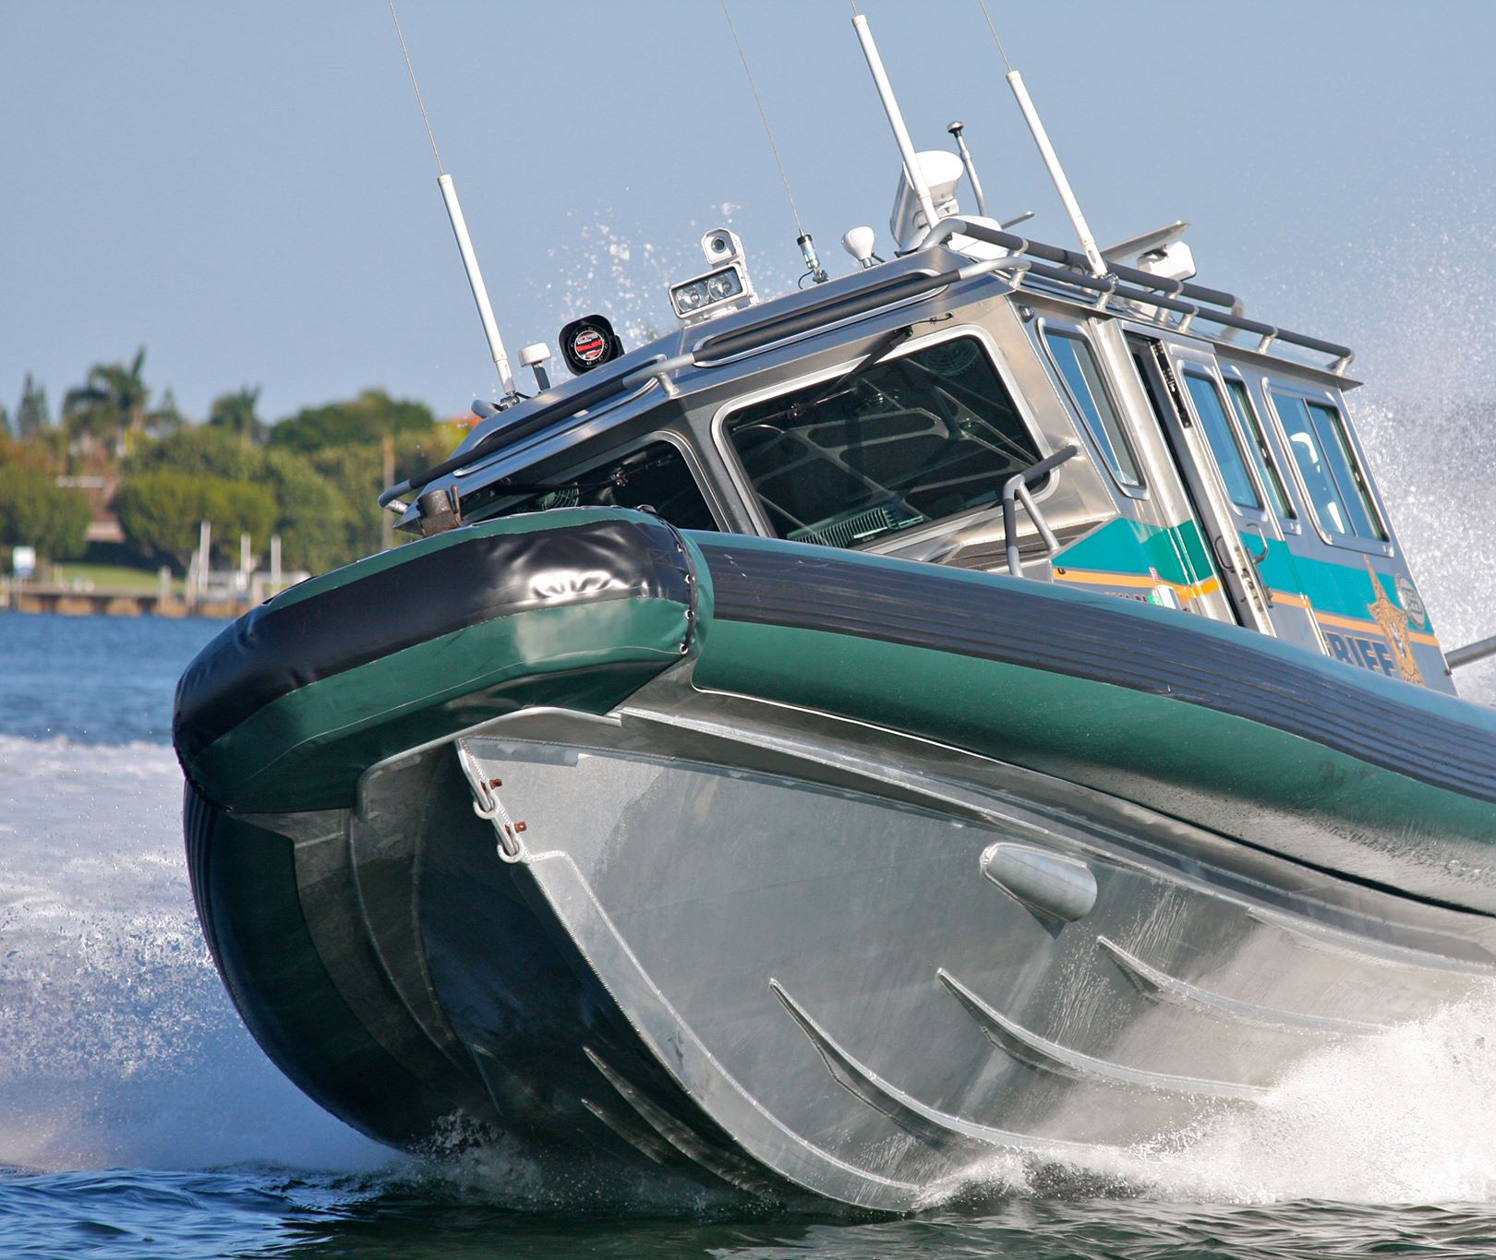
Law Enforcement

Slide 49
Law Enforcement
Level of Service
Service Area: Unincorporated County & 17 Cities
Variable | Weighted Population | Functional Population
Population | 943,870 | 802,190
Number of Sworn Officers | 1,675 | 1,675
LOS (Officers per 1,000 Population) | 1.77 | 2.09

Slide 50
Law Enforcement
Cost Component
Total vehicles & equipment = $260 M (incl. correctional)
Cost to Outfit an Officer = $74,000
  Total cost: $74,000 x 1,675 = $124 M
Component | Cost |  | Revised
Vehicle and Equipment Value per Officer | $55,000 |  | $74,000
LOS (Officers/1,000 functional residents) | 2.22 |  | 2.09
Cost per Functional Resident | $122.10 |  | $154.66

Slide 51
Law Enforcement
Credit Component
Number of Officers:
  2014 = 1,492
  2022 = 1,675
  Confirmed officer figures include same categories
  Serving 5 additional cities
Approximately 23 new officers per year
  $1.7 million of non-impact fee investment per year

Slide 52
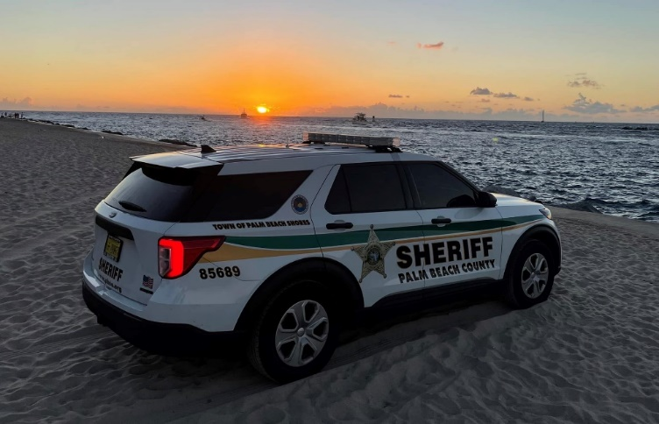
Law Enforcement
Net Cost per Resident
Total Cost = $154.66
Less: Credit = -$31.68
Net Cost = $122.98

Slide 53
Law Enforcement
Calculated Impact Fee
Land Use | Unit | Functional Residents per Unit | Fully Calculated Fee | Revised Calculated Fee | Current Adopted Fee
Residential
Single Family (detached/attached) | du | 1.88 | $230 | $231 | $128
Multi-Family | du | 1.13 | $138 | $139 | $70
Non-Residential
Light Industrial | 1,000 sf | 0.48 | $59 | $59 | $7
Office | 1,000 sf | 0.98 | $120 | $121 | $10
Retail/Shopping Center (40,000 to 150,000 sfgla) | 1,000 sfgla | 2.58 | $315 | $317 | $57
*Over the next four years

Slide 54
Law Enforcement
Calculated Impact Fee
Land Use | Unit | Fully Calculated Fee | Current Adopted Fee | HB 337 Capped Fee*
Residential
Single Family (detached/attached) | du | $231 | $128 | $192
Multi-Family | du | $139 | $70 | $105
Non-Residential
Light Industrial | 1,000 sf | $59 | $7 | $10
Office | 1,000 sf | $121 | $10 | $15
Retail/Shopping Center (40,000 to 150,000 sfgla) | 1,000 sfgla | $317 | $57 | $85
*Over the next four years

Slide 55
Law Enforcement
Impact Fee Component Changes since 2014-18 Study:
Input Variable | 2014-18 Study (Not Adopted) | 2021 Study | % Change
Residential 2,000 – 3,599 sf (per du)
Total/Net Impact Cost per Functional Resident | $107 | $123 | +15%
Functional Residents per Unit | 1.80 | 1.88 | +4%
Calculated Impact Fee | $192 | $231 | +20%

Slide 56
Law Enforcement
Impact Fee Comparison
Land Use | Unit | Palm Beach County |  |  | Collier County | Martin County | Miami-Dade County | Orange County | St. Lucie County
 |  | Current Adopted | Fully Calculated | HB 337 Capped*
Study Date | - | 2012 | 2021 | N/A | 2016 | 2012 | N/A | 2017 | 2016
Assessed Portion | - | 95% | N/A | N/A | 100% | 100% | N/A | 100% | 100%
Residential
Single Family (2,000 sf) | du | $128 | $231 | $192 | $587 | $760 | $583 | $502 | $246
Multi-Family (1,300 sf) | du | $70 | $139 | $105 | $297 | $760 | $583 | $194 | $171
Non-Residential
Light Industrial | 1,000 sf | $7 | $59 | $10 | $215 | $158 | $405 | $146 | $54
Office (50,000 sf) | 1,000 sf | $10 | $121 | $15 | $372 | $274 | $405 | $265 | $187
Retail (125,000 sf) | 1,000 sfgla | $57 | $317 | $85 | $765 | $742 | $405 | $786 | $325
*Over the next four years

Slide 57
Law Enforcement
Contracts with the Cities
Contracts reflect a single negotiated rate for an agreed upon level of service
PBSO adds officers every time they contract with a new city and revenues from the contract assist with the cost of the officers
  5 additional jurisdictions since the 2014/18 report

Slide 58
Law Enforcement
Revenue Projections
  Based on permitting levels from 2015+
    Full calculated rates ≈$0.6 million per year
    HB 337 capped rates ≈$0.5 million per year
  Examples of projects eligible for impact fee funding
    Additional vehicles/equipment (new)

Slide 59
Summary
Summary of Calculated Impact Fee Rates:
Land Use | Unit | Public Buildings | Fire Rescue | Law Enforcement | Library Facilities | Parks & Recreation (Excl Beach) | School Facilities | Transportation | Total Calculated | Total Adopted
Residential
Single Family (2,000 sf) | du | $1,572 | $628 | $231 | $311 | $2,332 | $8,322 | $5,892 | $19,288 | $13,055
Non-Residential
Light Industrial | 1,000 sf | $465 | $154 | $59 |  |  | - | $2,633 | $3,311 | $1,683
Office (50,000 sf) | 1,000 sf | $950 | $85 | $121 |  |  | - | $5,847 | $7,003 | $3,609
Retail (125,000 sfgla) | 1,000 sfgla | $2,502 | $172 | $317 |  |  | - | $8,323 | $11,314 | $8,170

Slide 60
Summary
Summary of Calculated Impact Fee Rates (Reduced Parks & Public Buildings):
Land Use | Unit | Public Buildings | Fire Rescue | Law Enforcement | Library Facilities | Parks & Recreation | School Facilities | Transportation | Total Calculated | Total Adopted
Residential
Single Family (2,000 sf) | du | $1,094 | $628 | $231 | $311 | $1,474 | $8,322 | $5,892 | $17,952 | $13,055
Non-Residential
Light Industrial | 1,000 sf | $325 | $154 | $59 |  |  | - | $2,633 | $3,171 | $1,683
Office (50,000 sf) | 1,000 sf | $663 | $85 | $121 |  |  | - | $5,847 | $6,716 | $3,609
Retail (125,000 sfgla) | 1,000 sfgla | $1,745 | $172 | $317 |  |  | - | $8,323 | $10,557 | $8,170

Slide 61
Summary
Summary of HB 337 Capped Impact Fee Rates:
Land Use | Unit | Public Bldgs | Fire Rescue | Law Enf | Library | Parks & Recr | School | Transp | HB 337 Capped Fees* | Total Adopted
Residential
Single Family (2,000 sf) | du | $334 | $414 | $192 | $311 | $1,290 | $8,322 | $5,892 | $16,755 | $13,055
Non-Residential
Light Industrial | 1,000 sf | $110 | $120 | $11 |  |  | - | $2,284 | $2,525 | $1,683
Office (50,000 sf) | 1,000 sf | $196 | $75 | $15 |  |  | - | $5,127 | $5,413 | $3,609
Retail (125,000 sfgla) | 1,000 sfgla | $504 | $172 | $86 |  |  | - | $8,323 | $9,085 | $8,170
*Over the next four years

Slide 62
Presentation Overview
Background/Purpose
Technical Study
  Public Buildings
  Fire Rescue
  Law Enforcement
  Library Facilities
  Parks & Recreation Facilities
  School Facilities
  Transportation
Next Steps

Slide 63
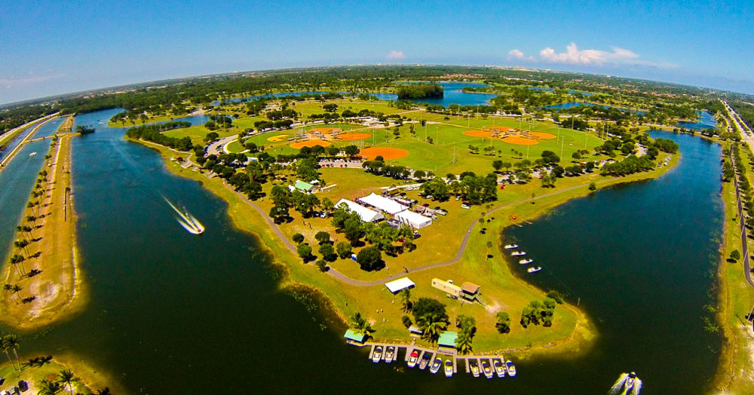
Next Steps
  Impact Fee Review Committee Recommendations
  Final Technical Report
  BOCC Workshop
  Implementation Process

Slide 64
Questions?

